Slide 1
CMC: Chord Plots
Update: 12/25/2024

Slide 2
Identify a connection
Subtract baseline
Take overall mean dDTF across all subjects (netVals_ave)
Take mean dDTF for each subject and put it in an array (netVals)
Identify significant connections from netvals
Plot chord diagrams from netVals_ave, color them based on significance
From Steve Peterson’s template:
Identify a connection from connStruct
Take overall mean (netVals_ave)
Take mean across frequency for each connection and put it in an array (netVals)
Identify significant connections from netvals
Plot chord diagrams from netVals_ave, color them based on significance
Construct connectivity structure after baseline subtraction and taking median across subjects (connStruct)
From SfN:

Slide 3
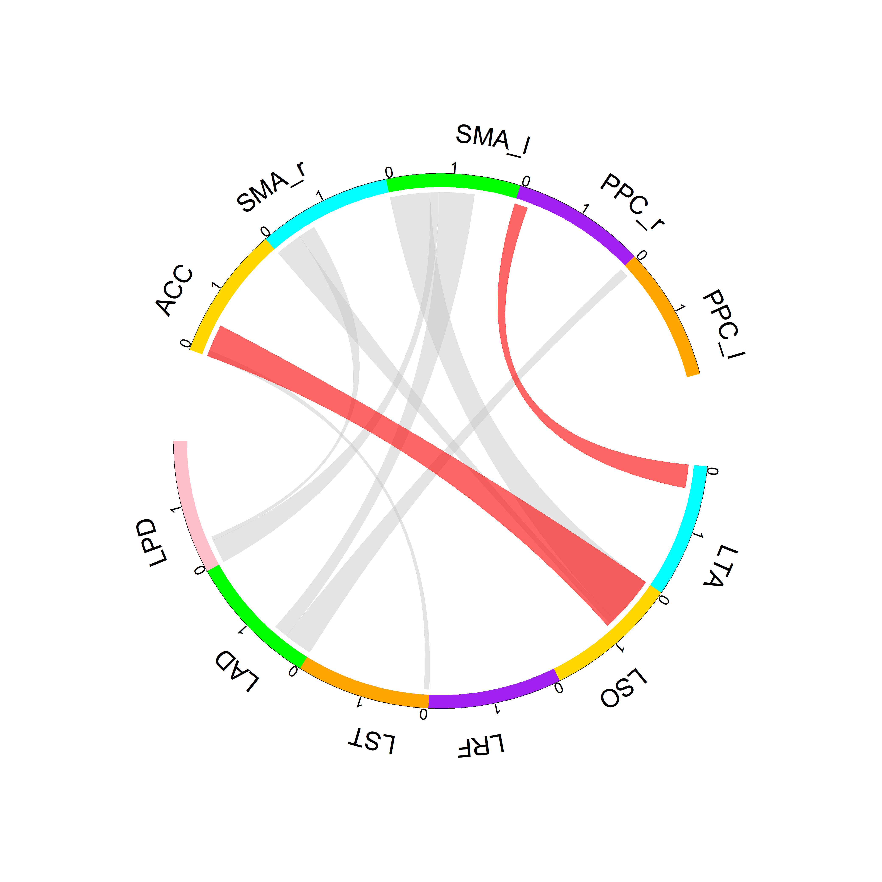
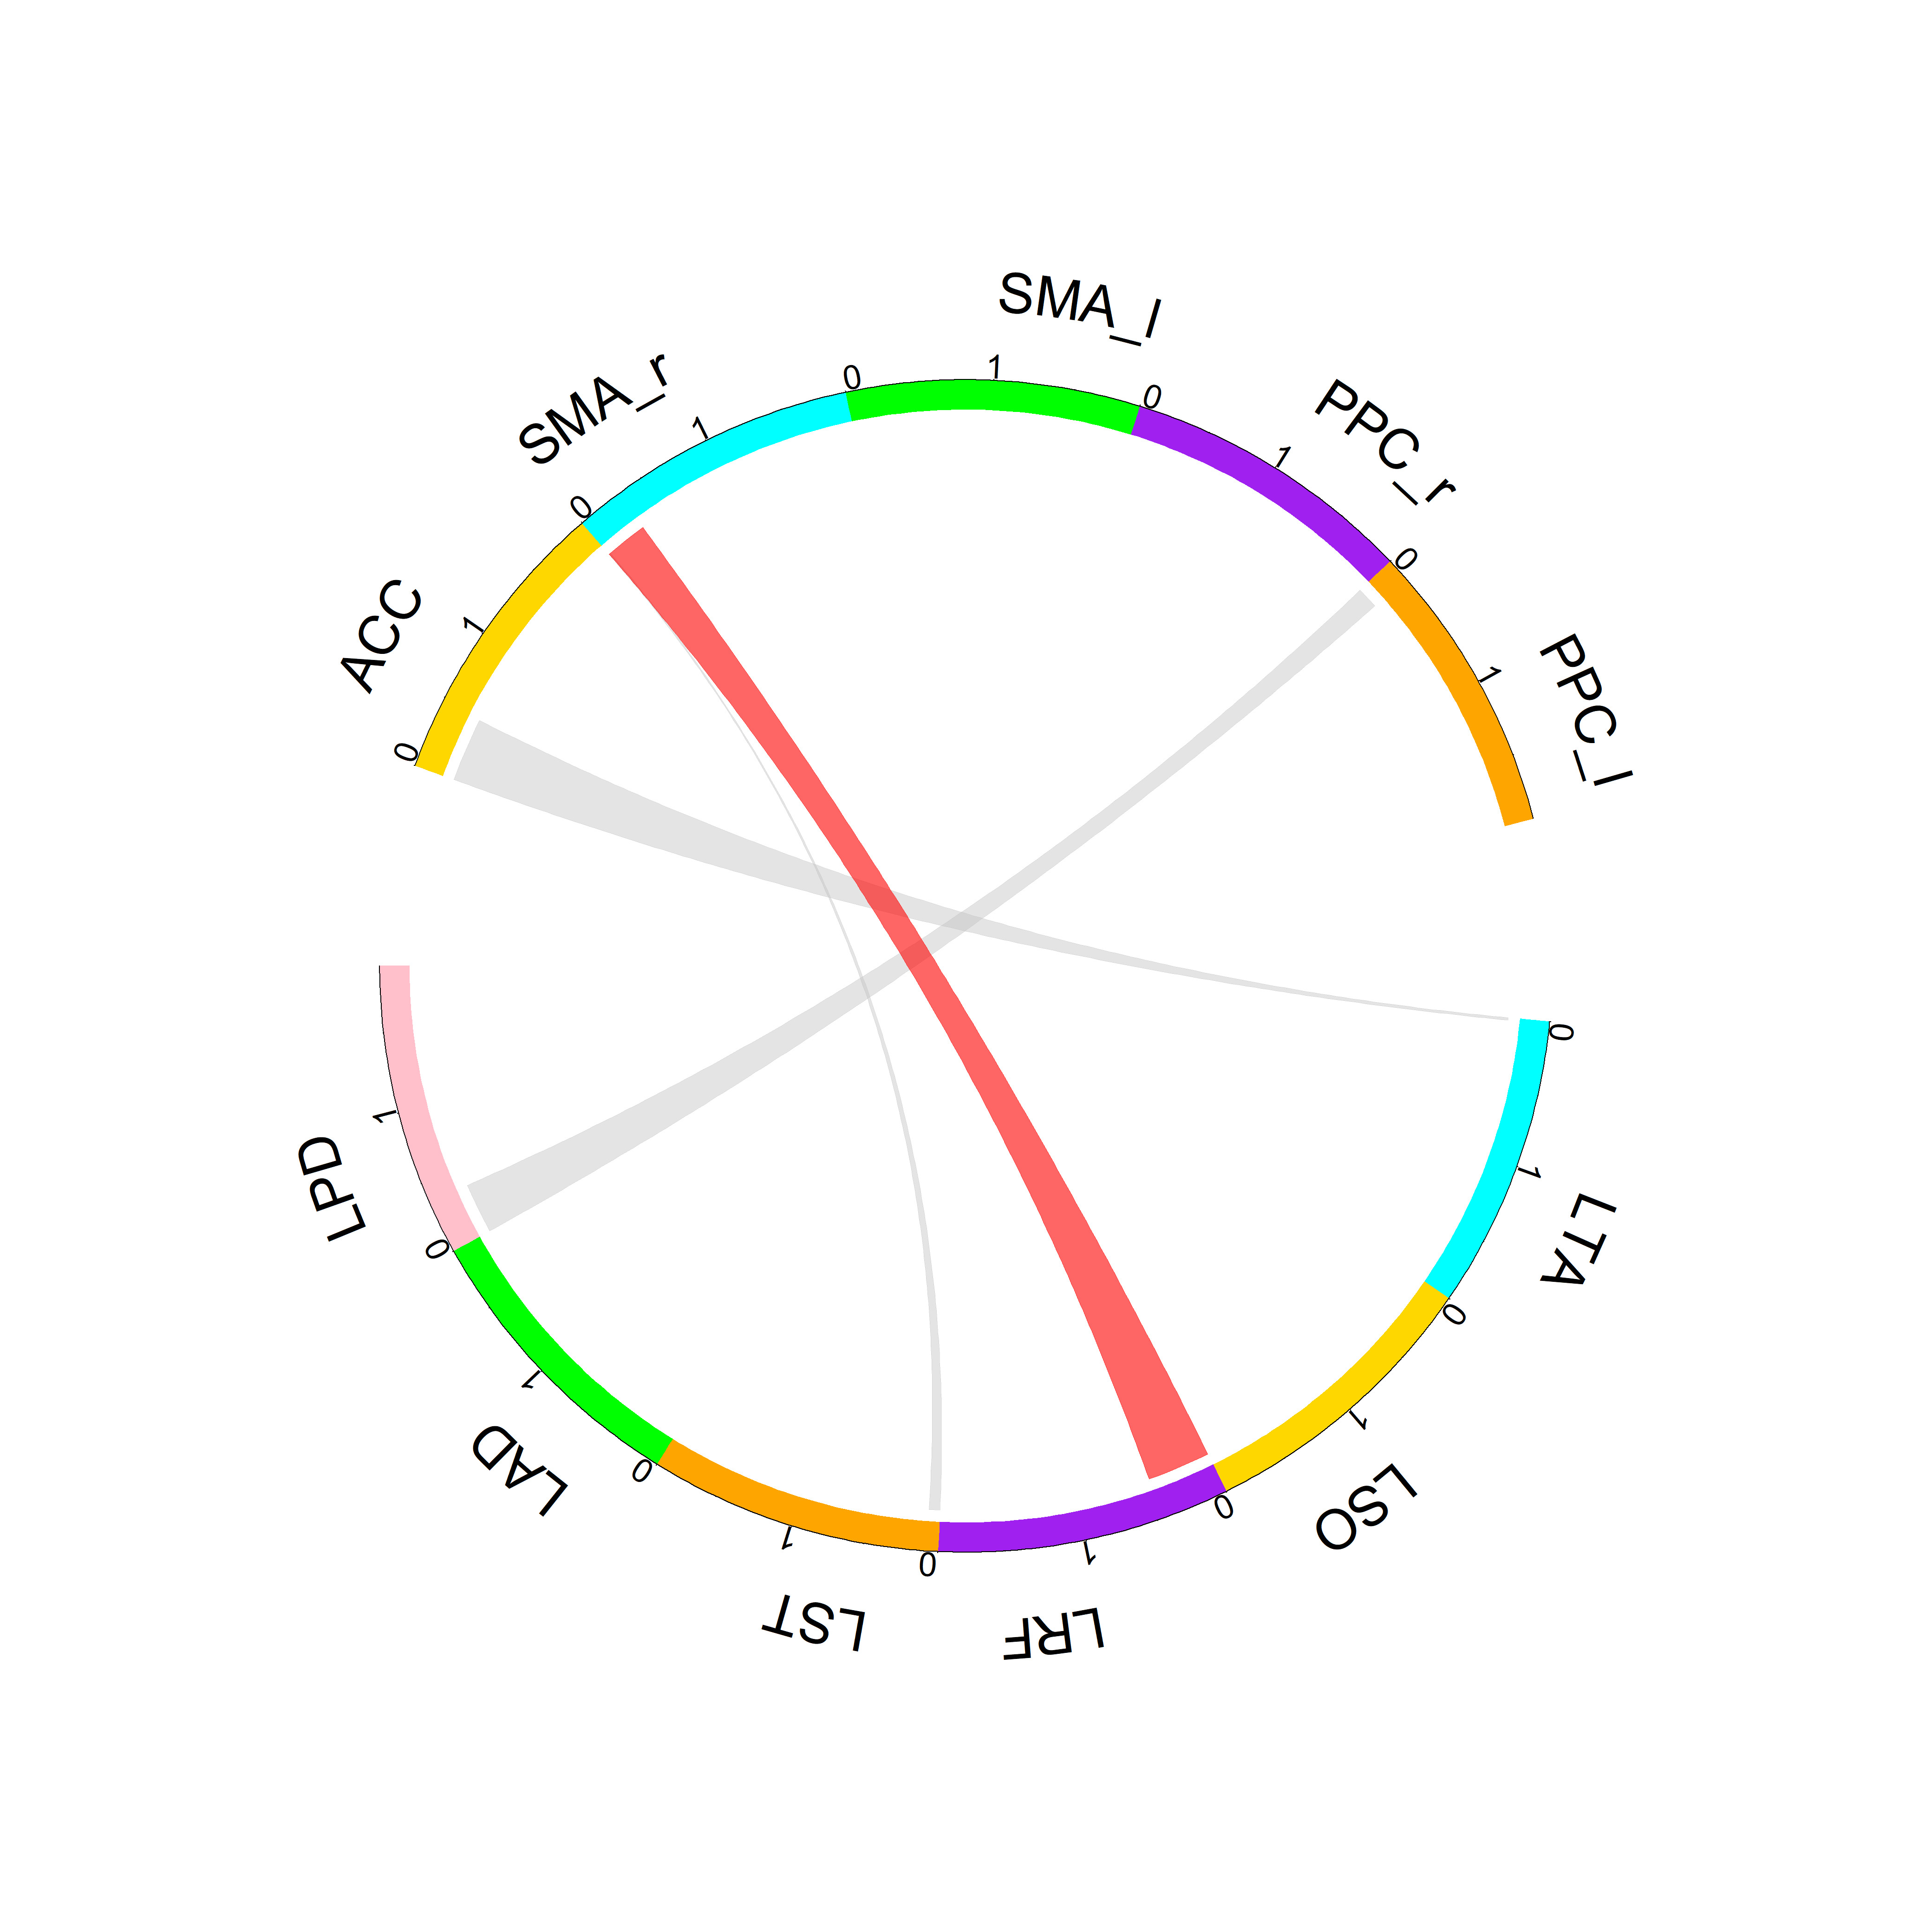
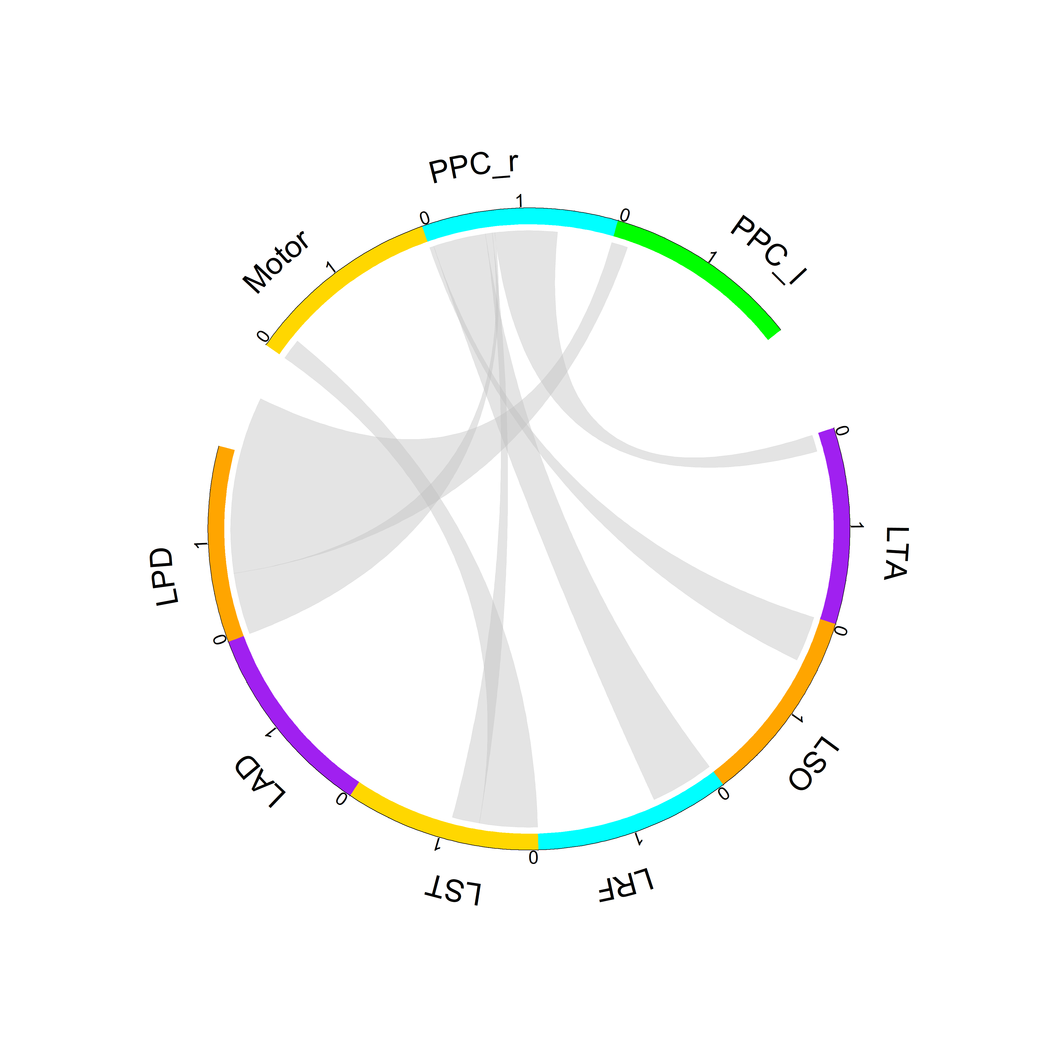
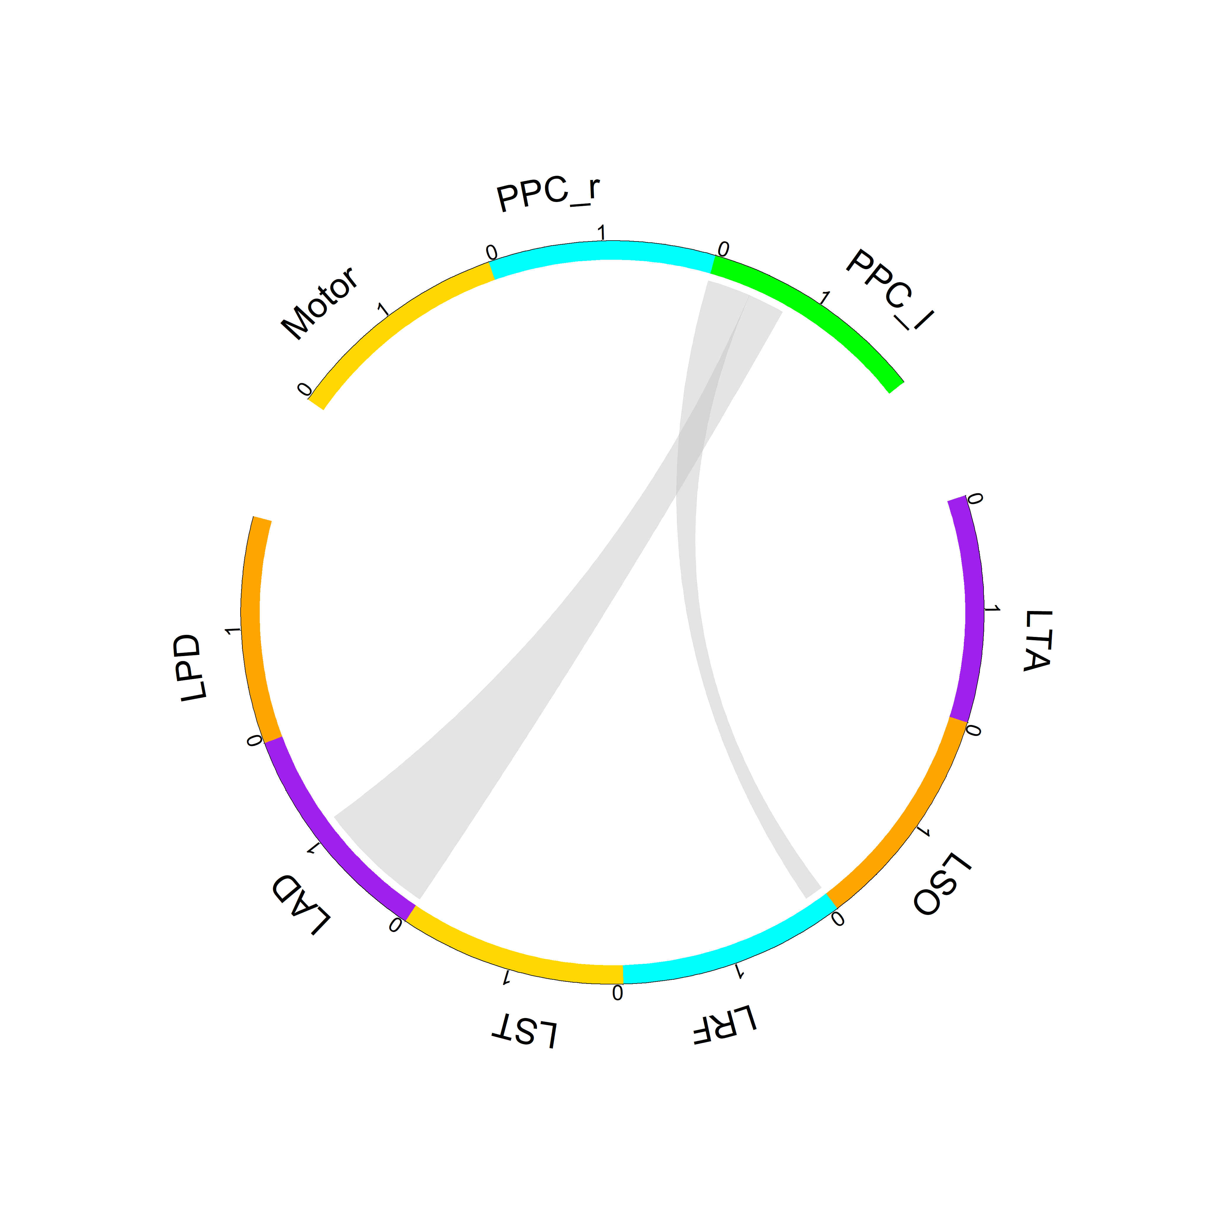
LEI
LME
Young
Steve Peterson’s Template
Alpha
Older

Slide 4
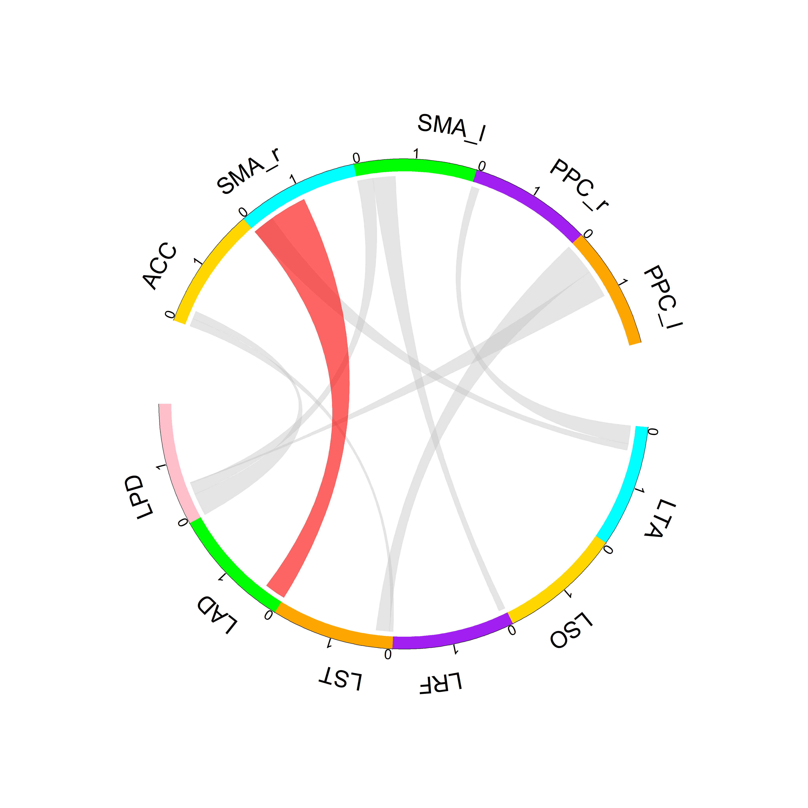
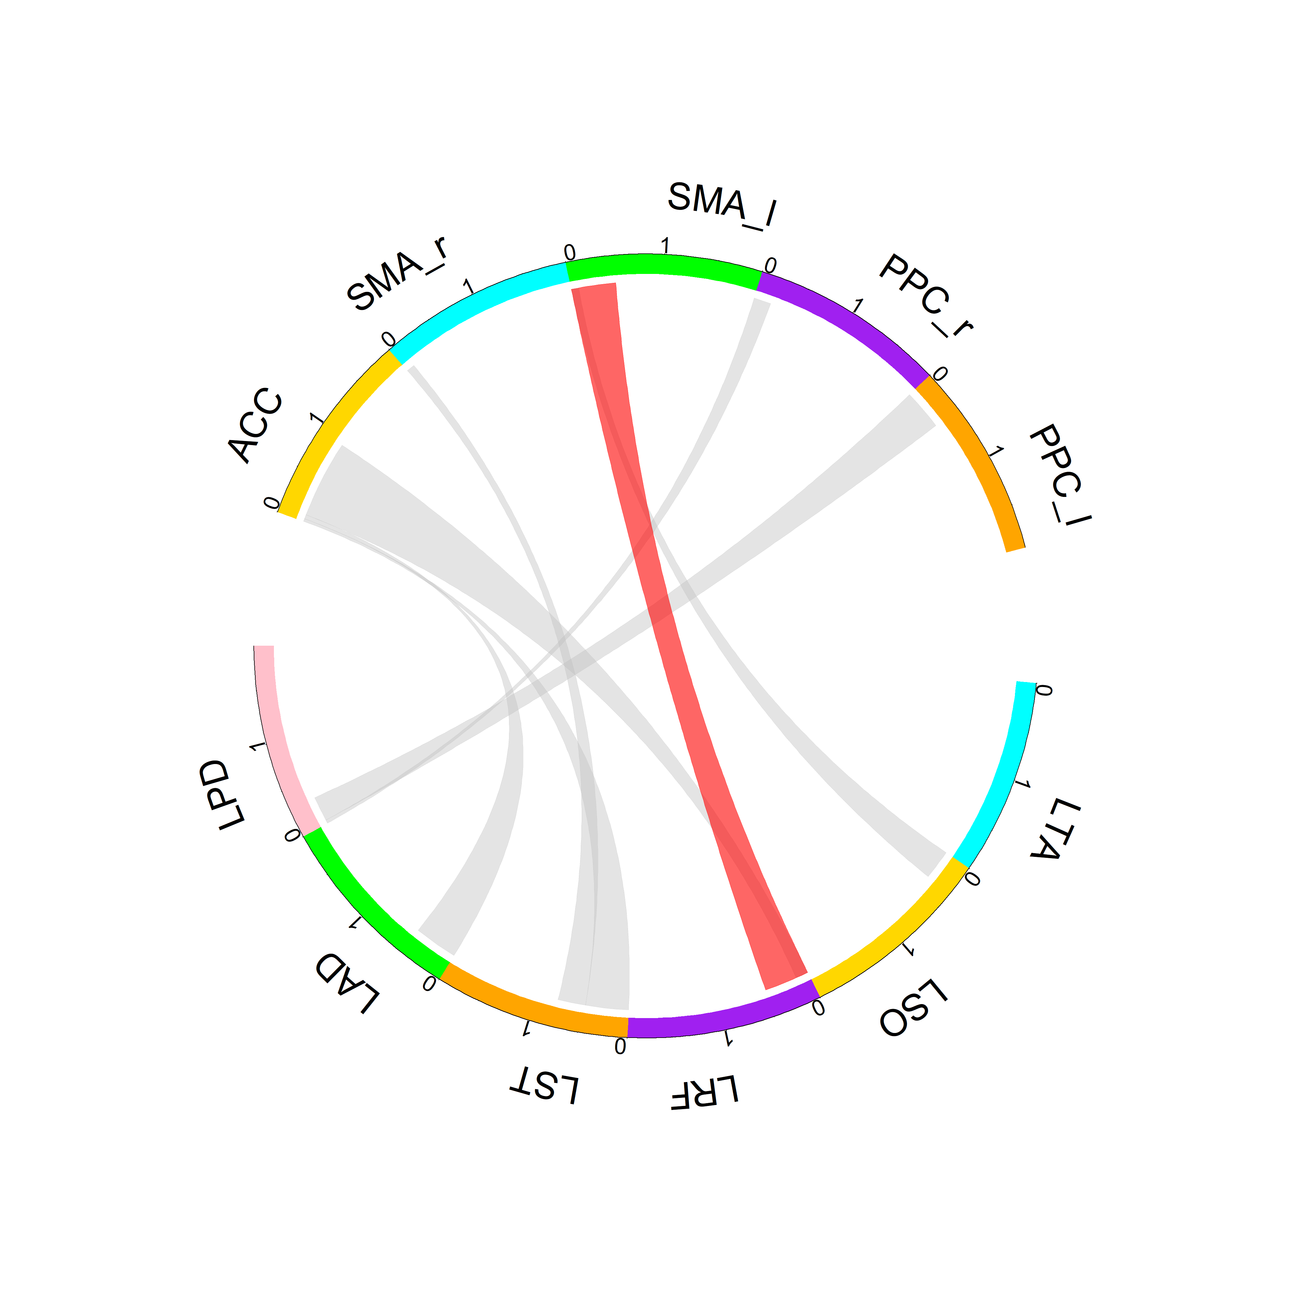
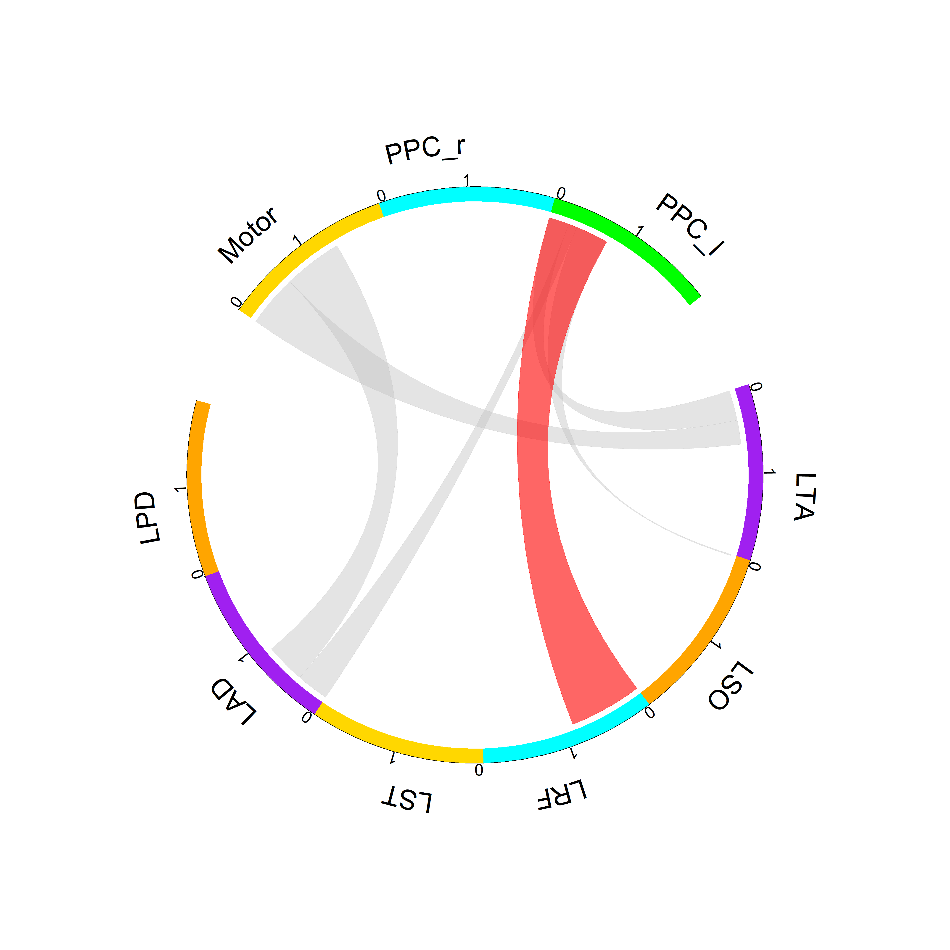
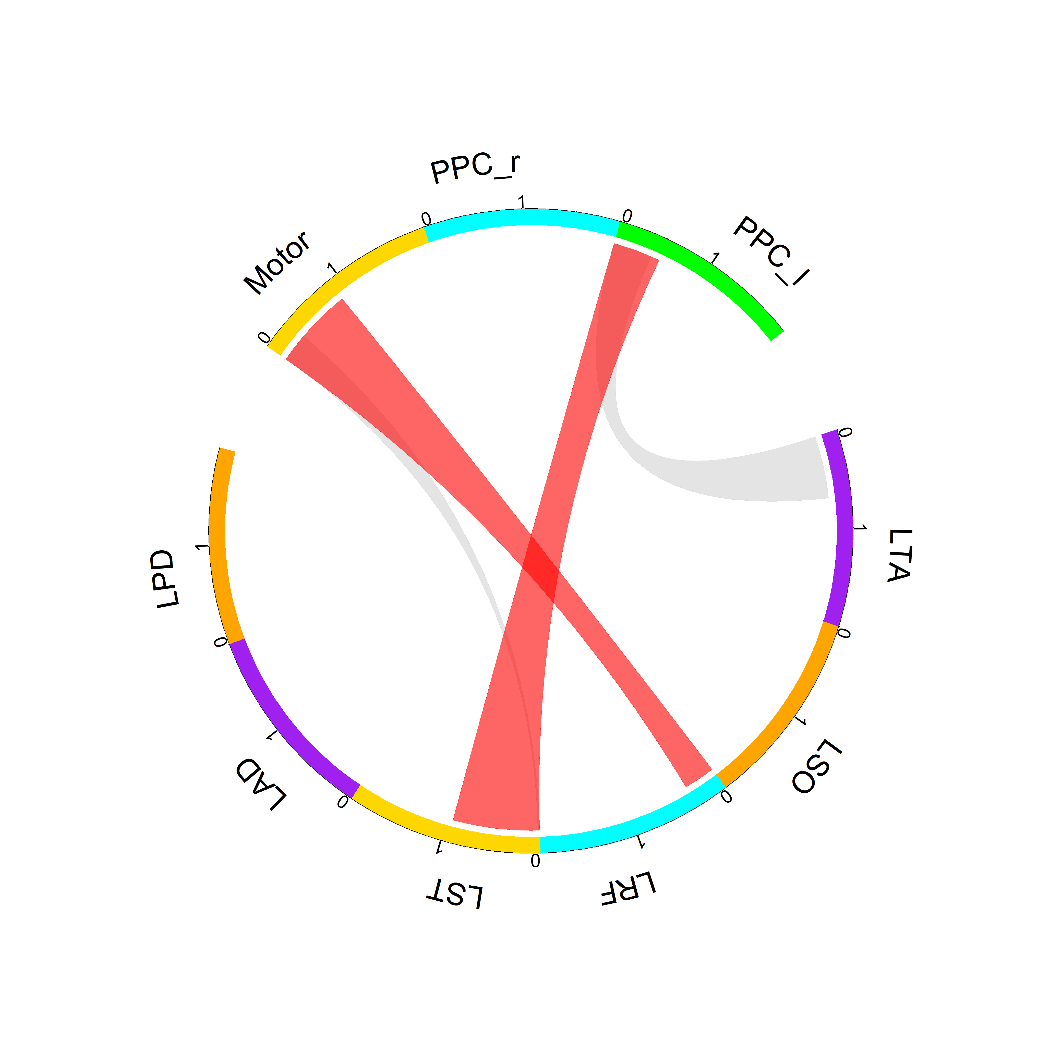
LEI
LME
Young
Theta
Older

Slide 5
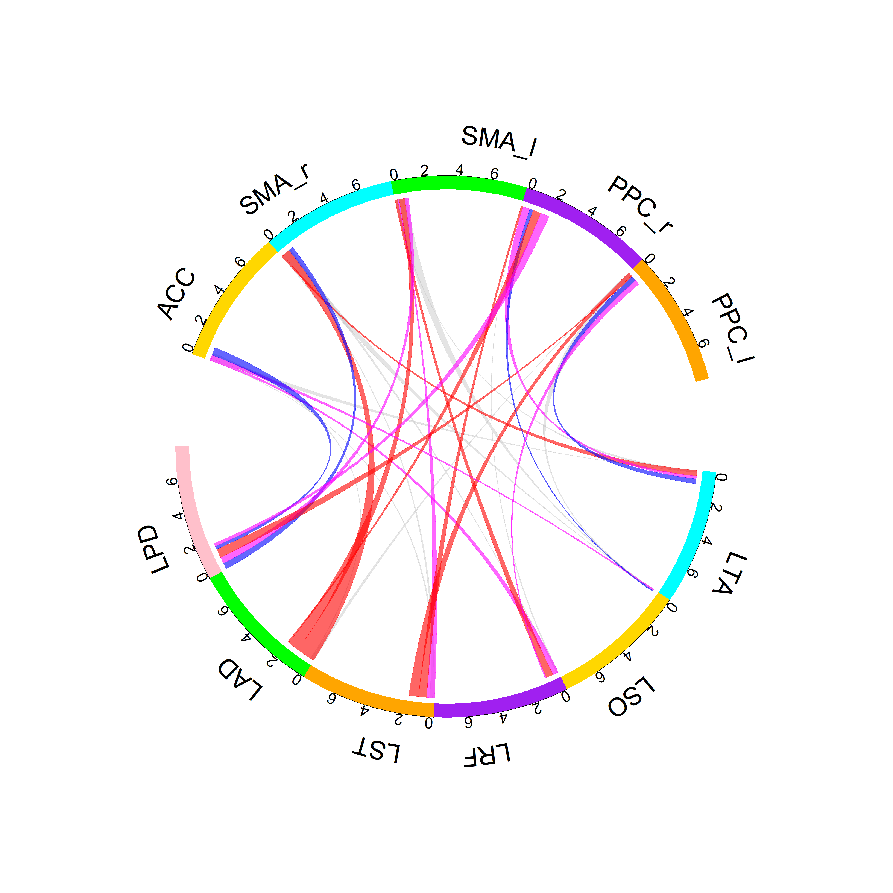
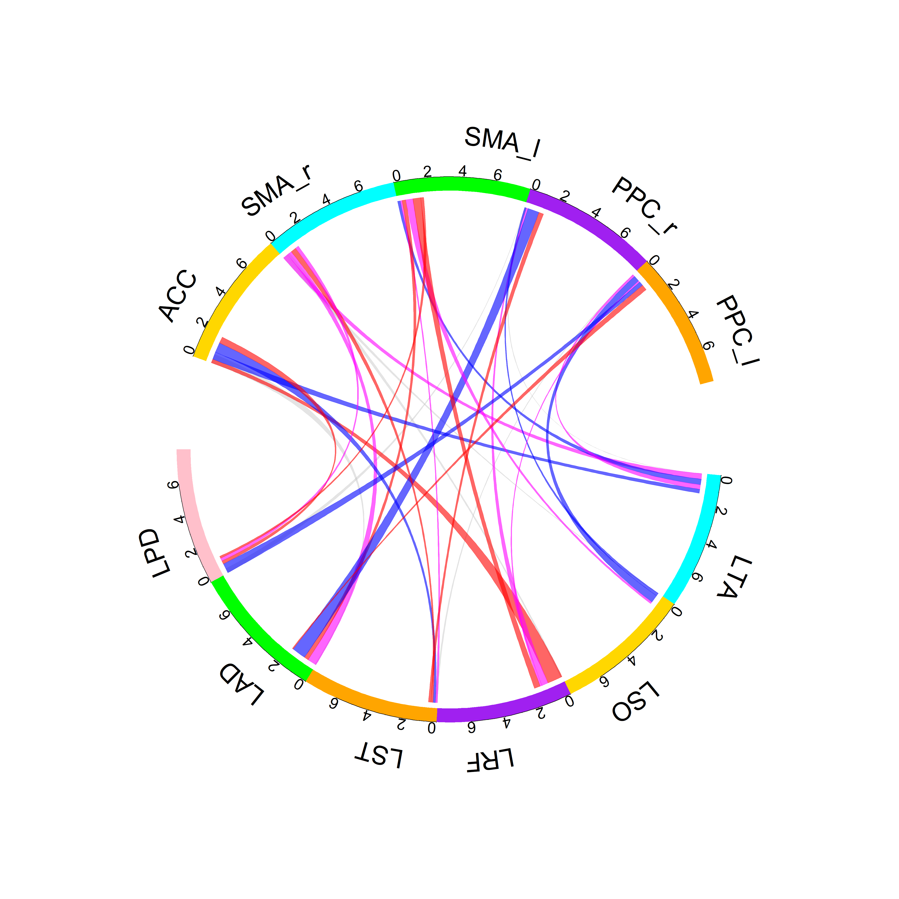
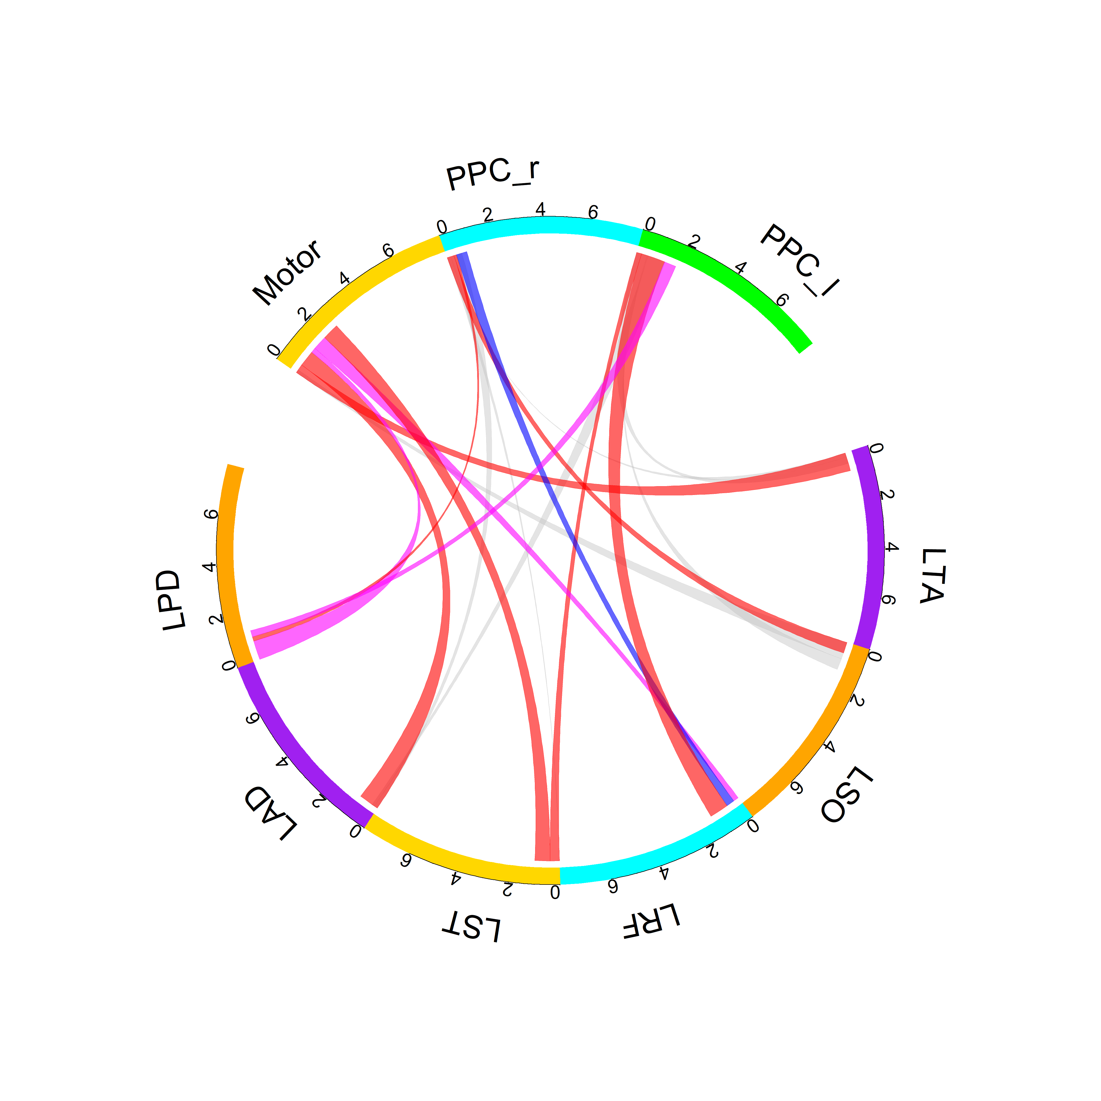
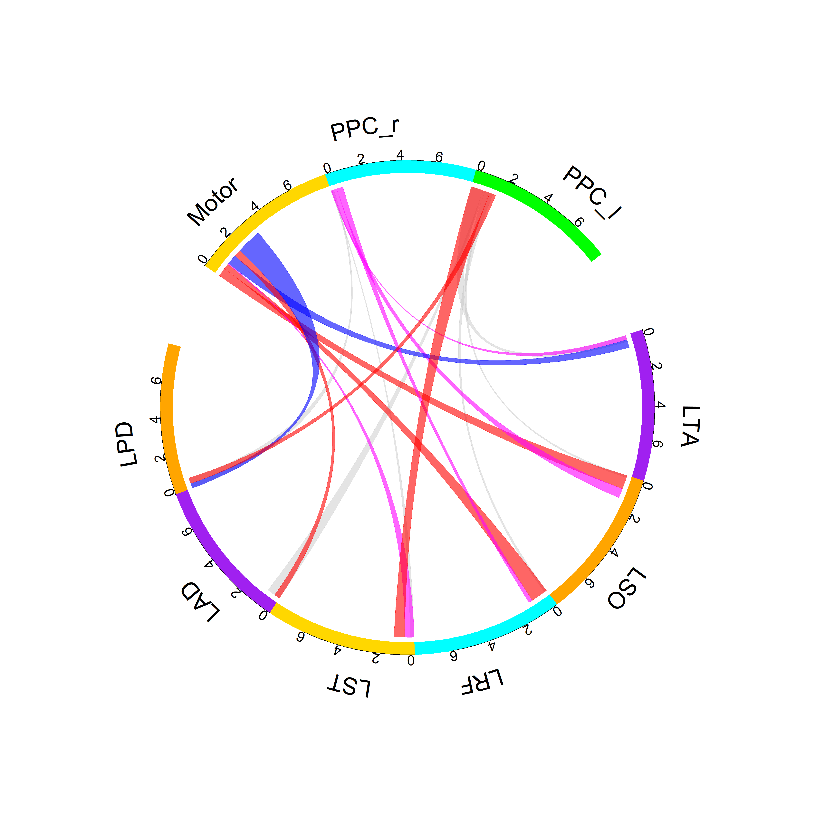
LEI
LME
Young
SfN
Alpha
Older

Slide 6
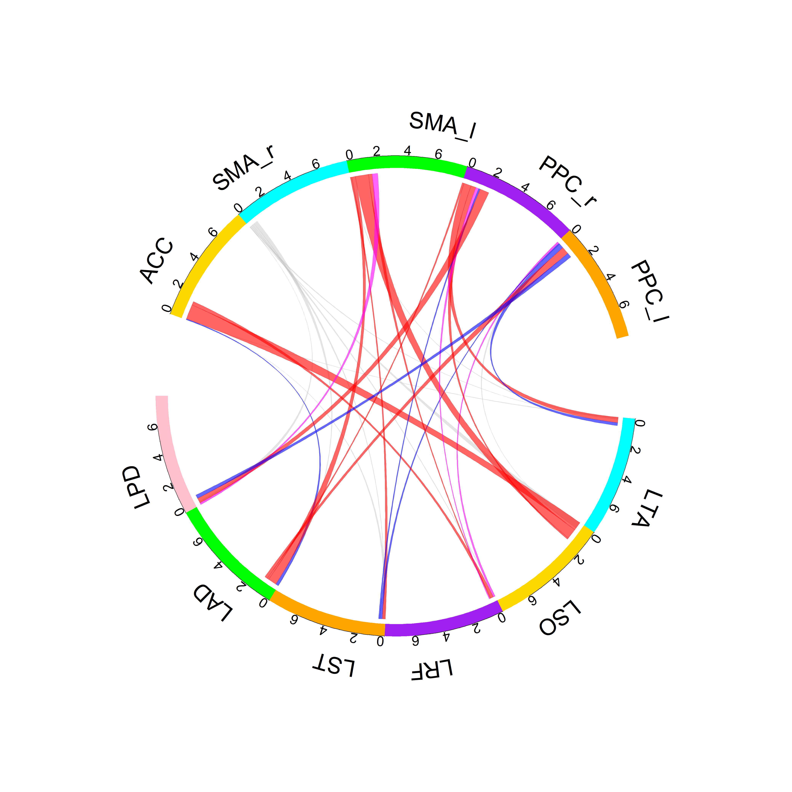
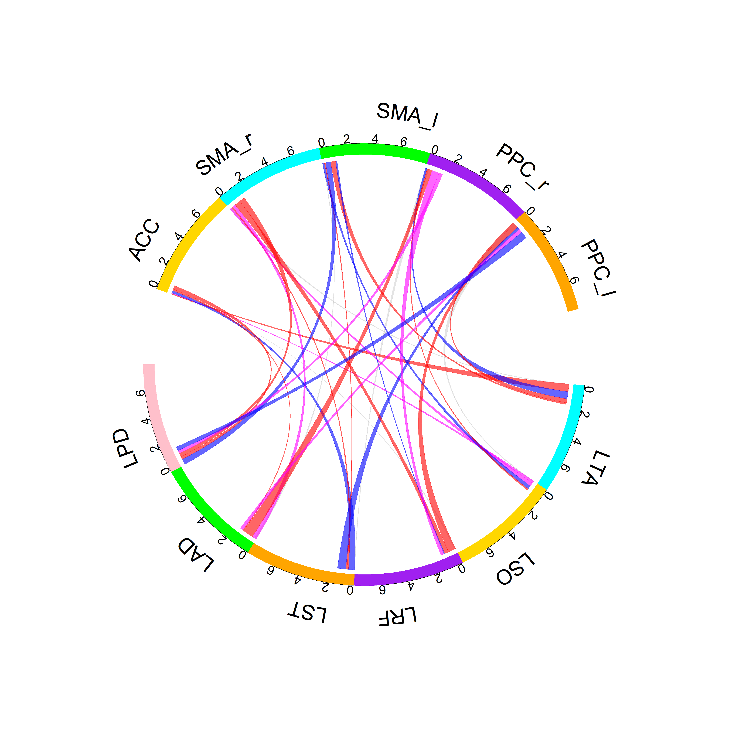
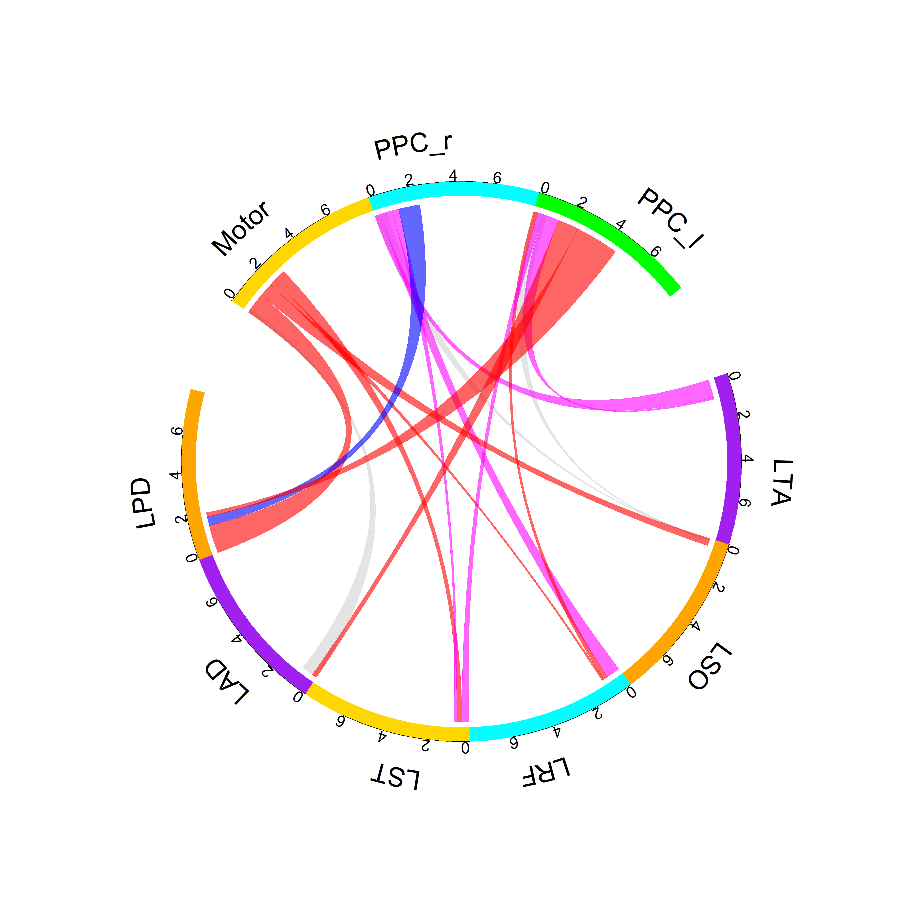
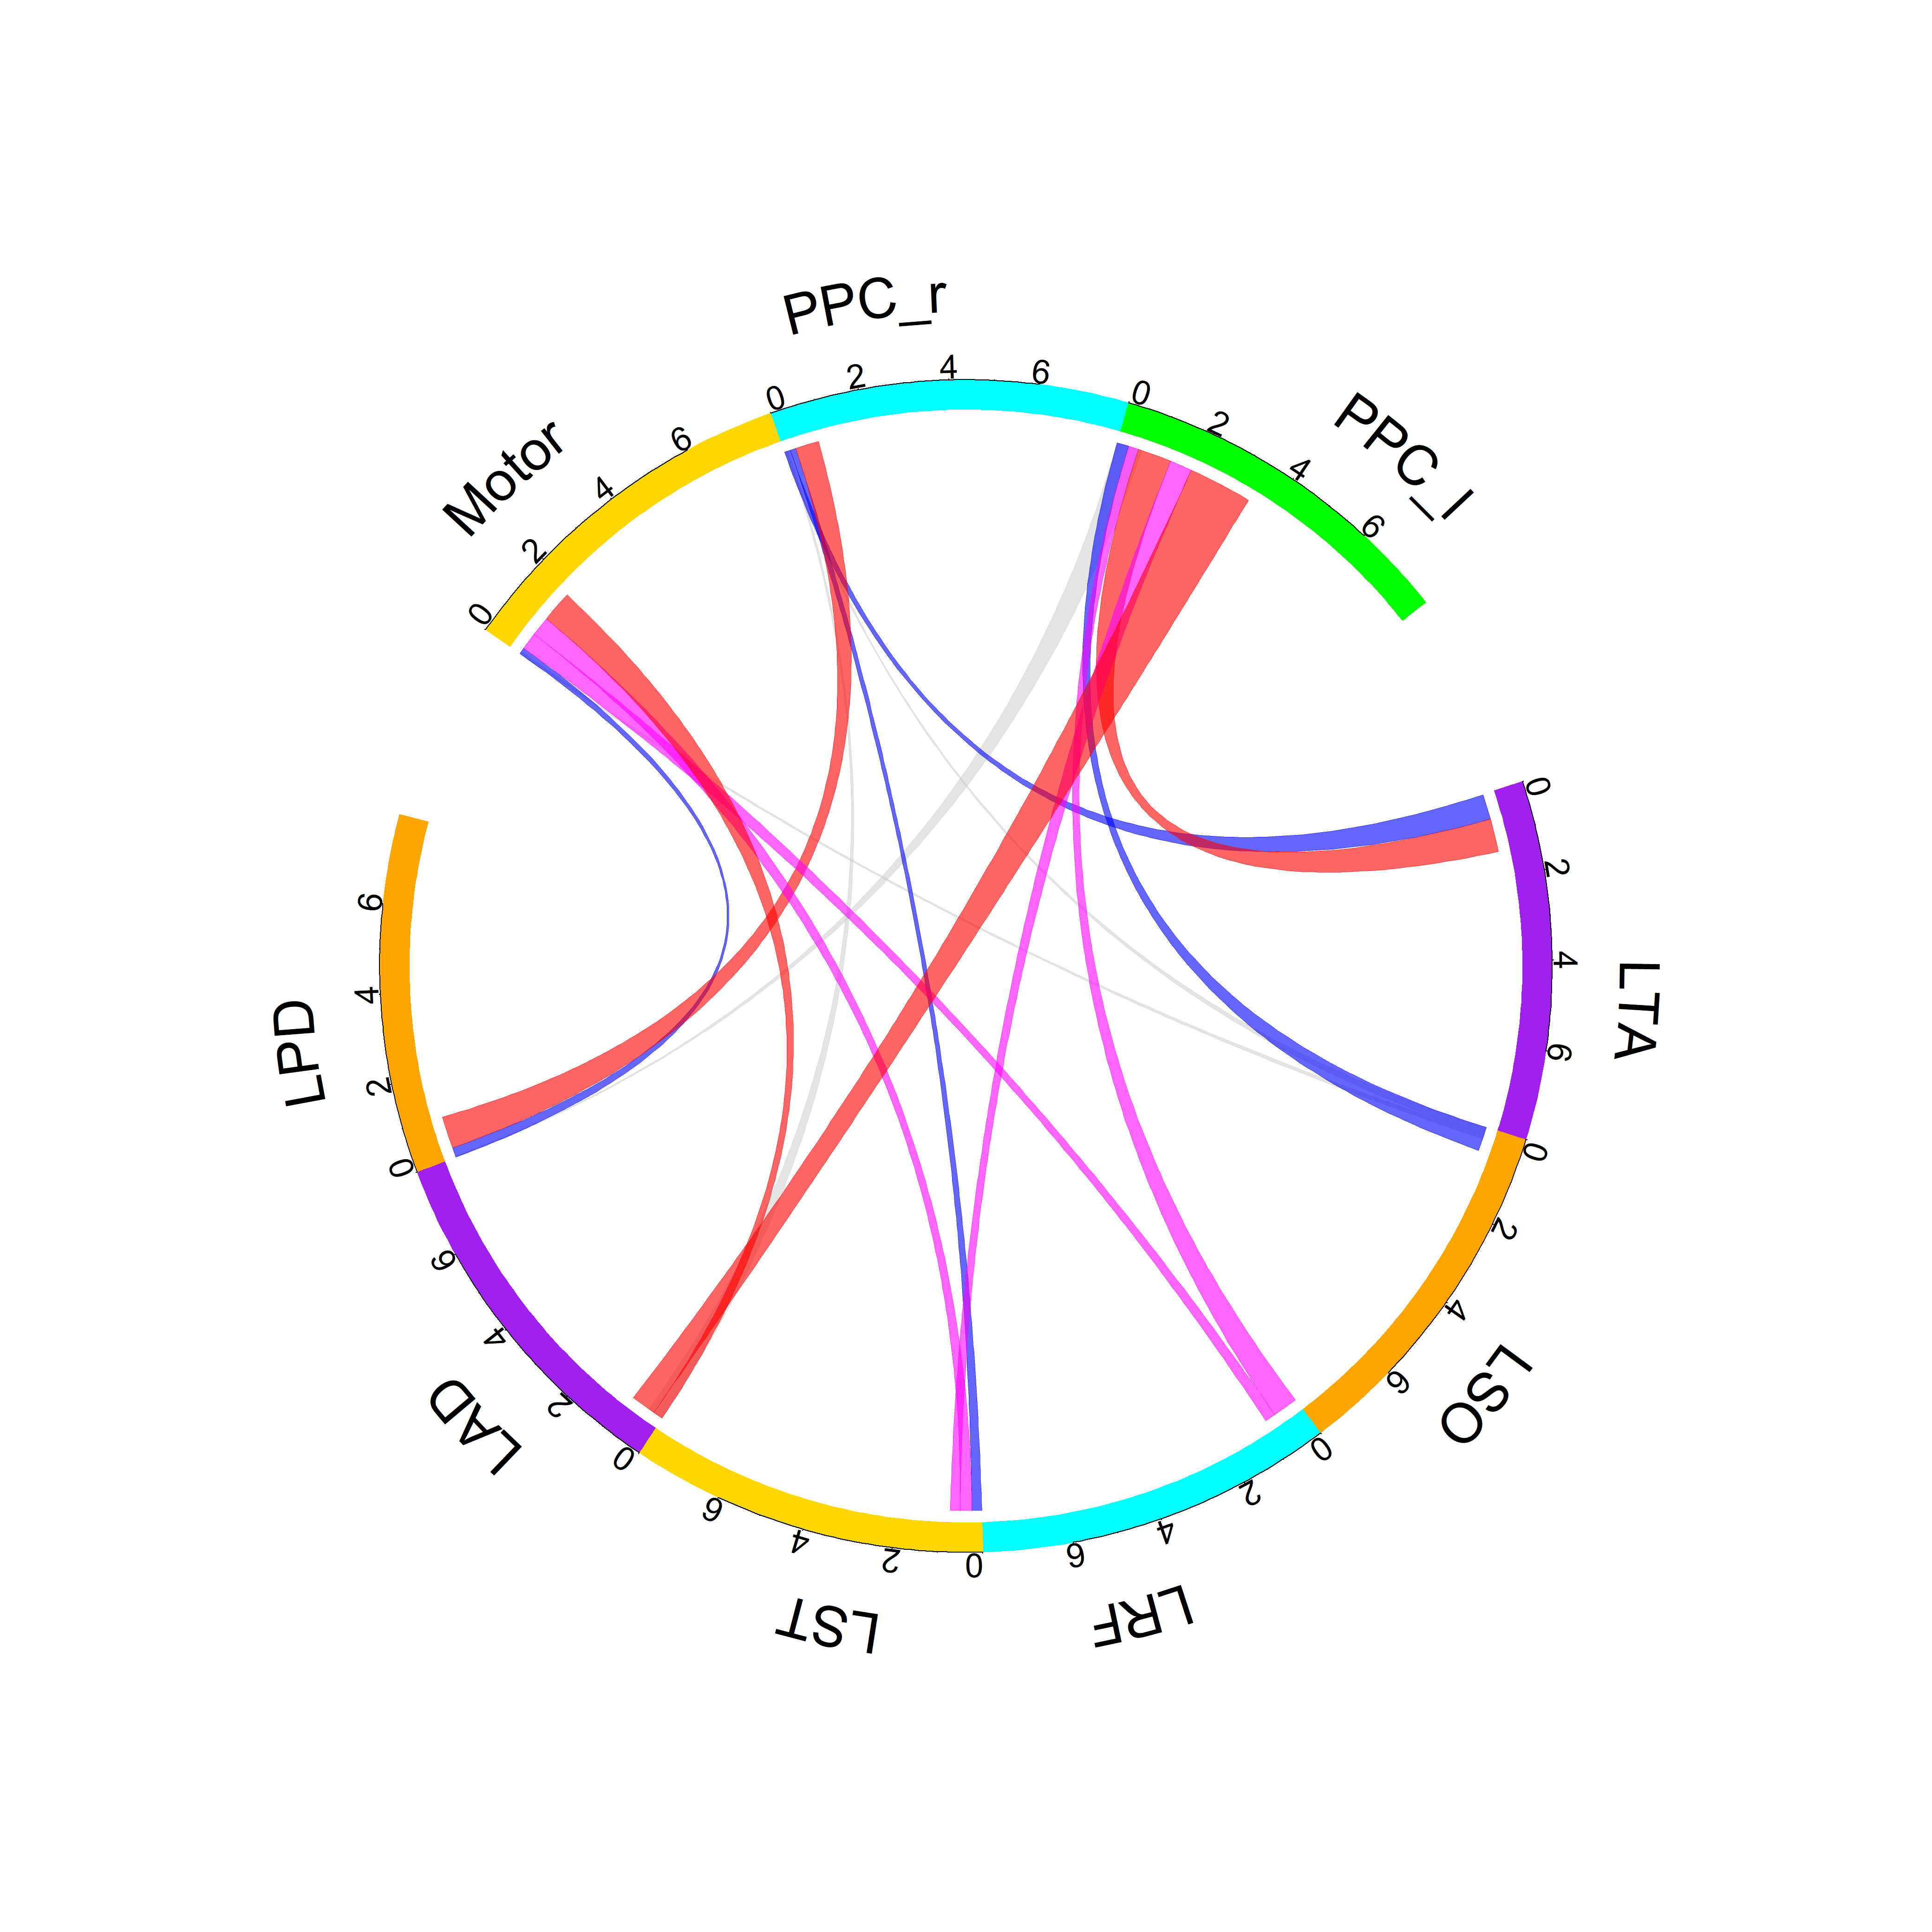
LEI
LME
Young
Theta
Older

Slide 8
Young – LEI - Alpha

Slide 9
Update: 1/8/2025

Slide 10
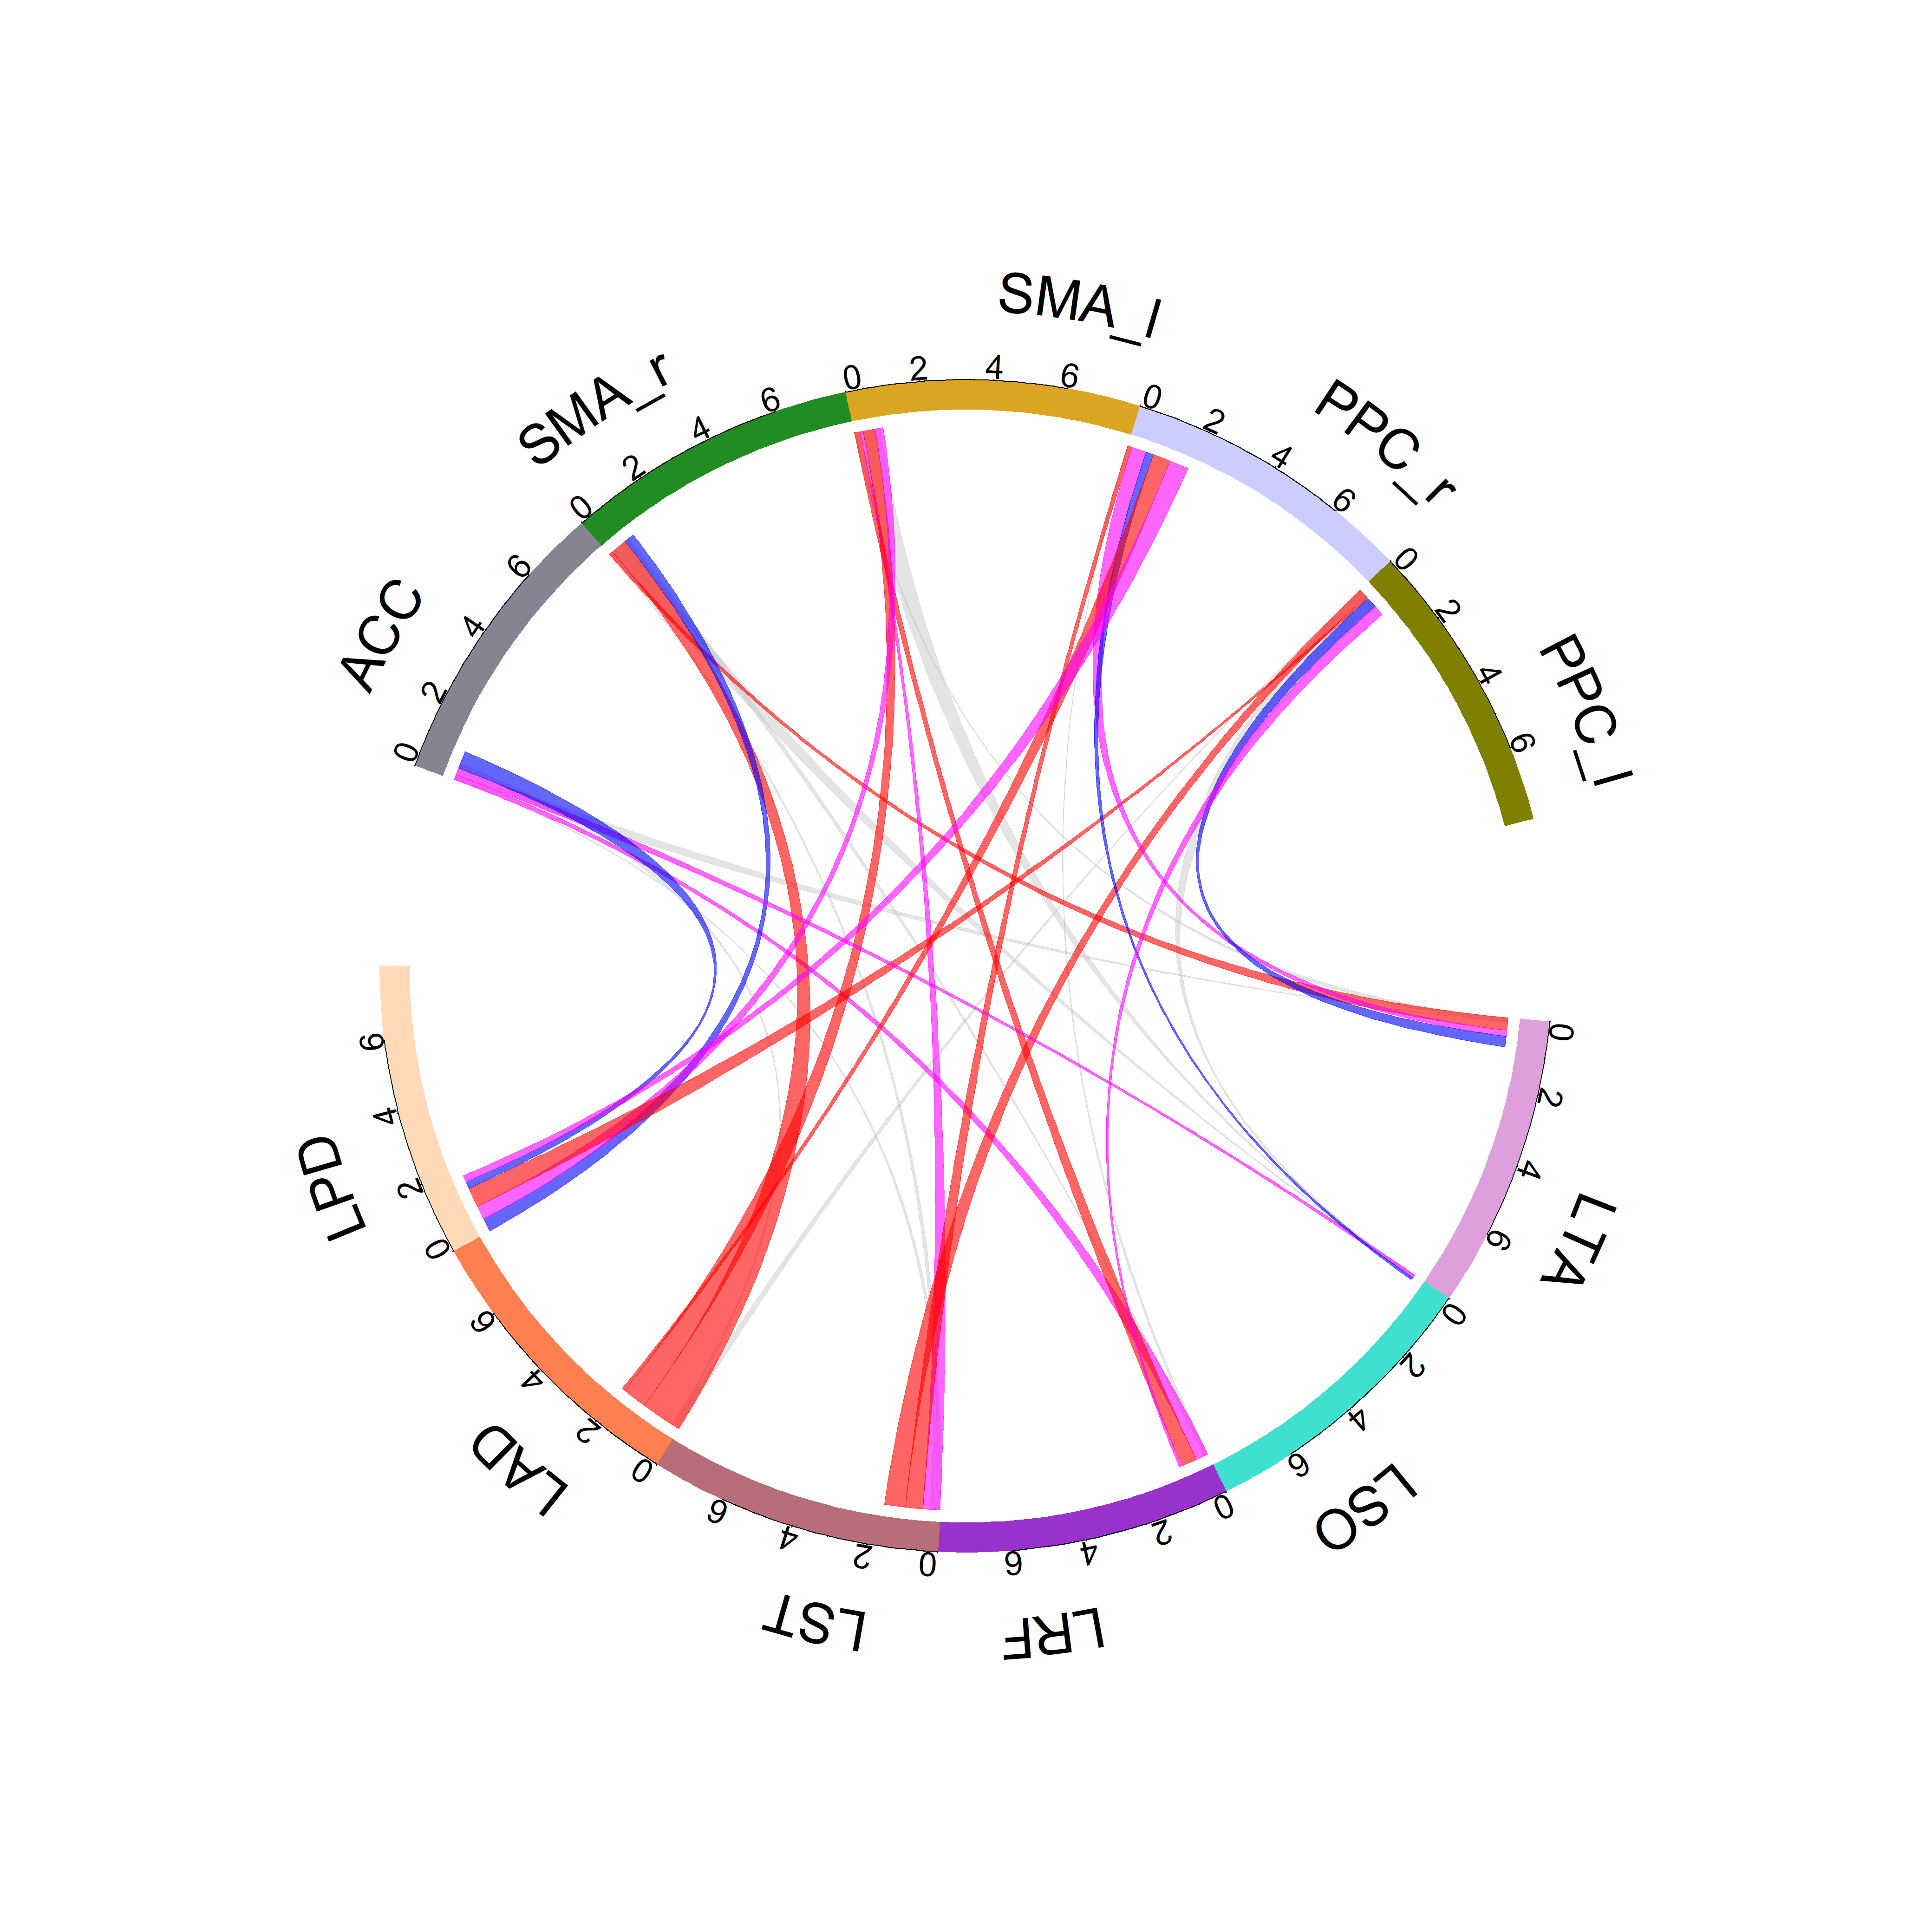
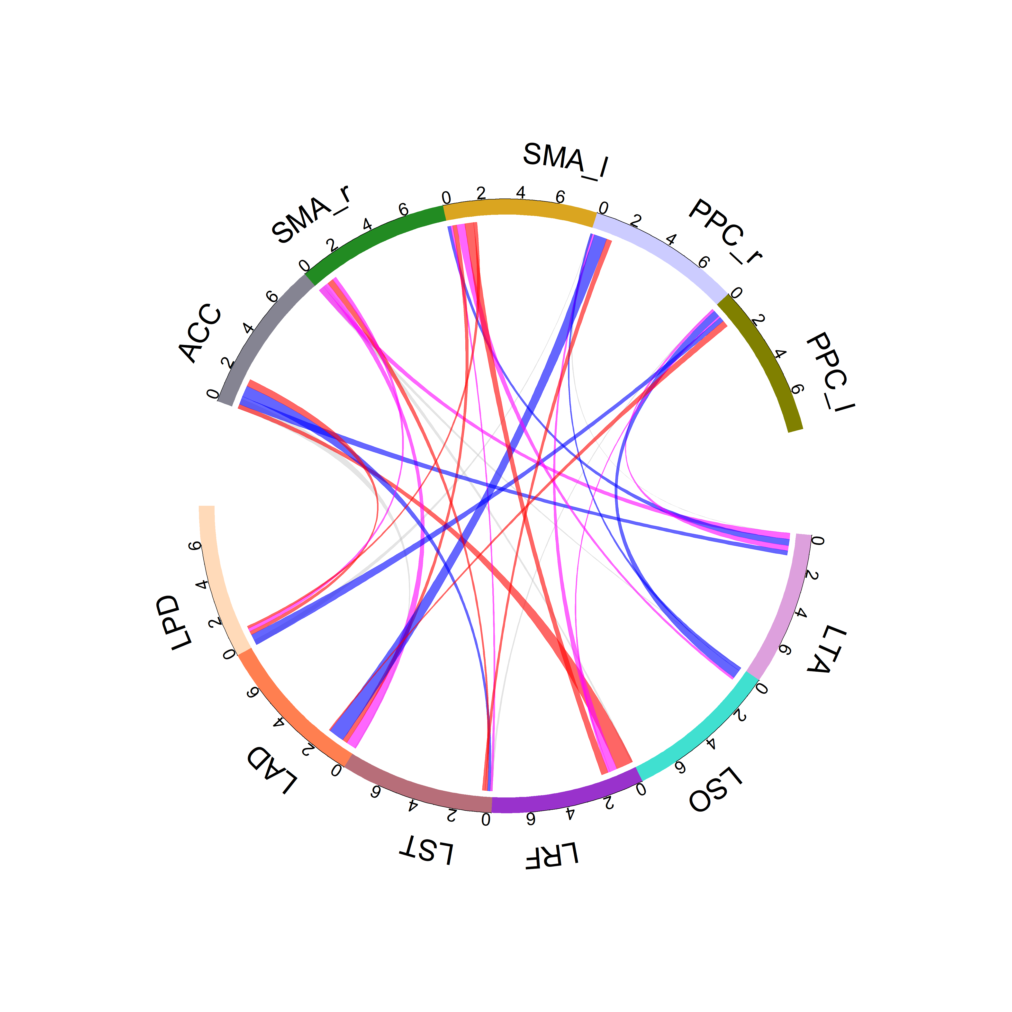
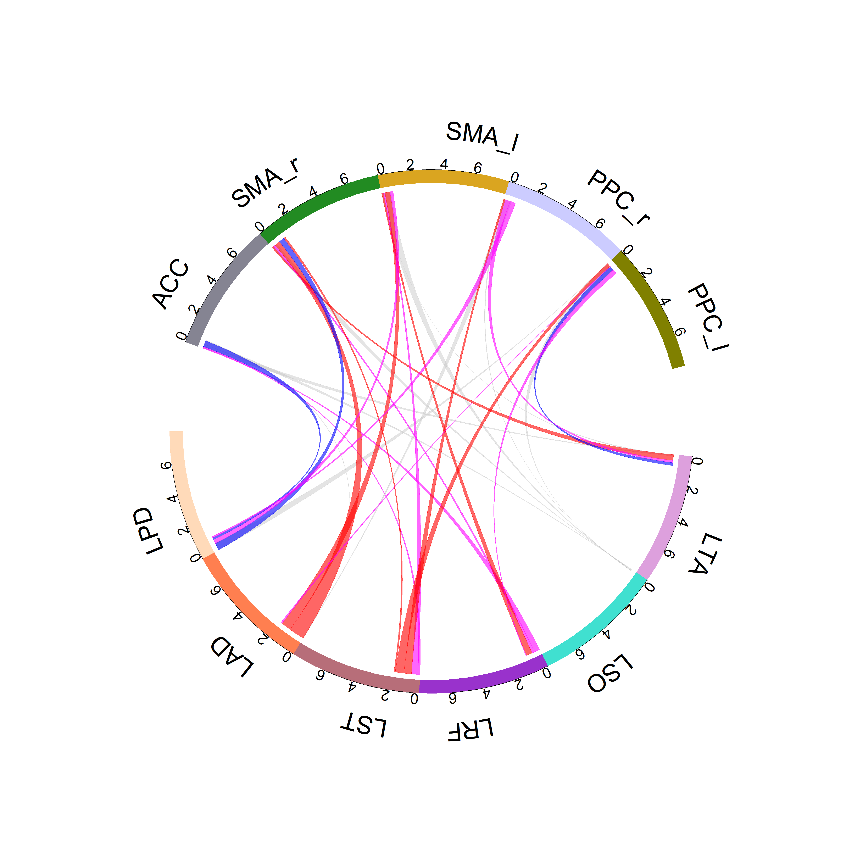
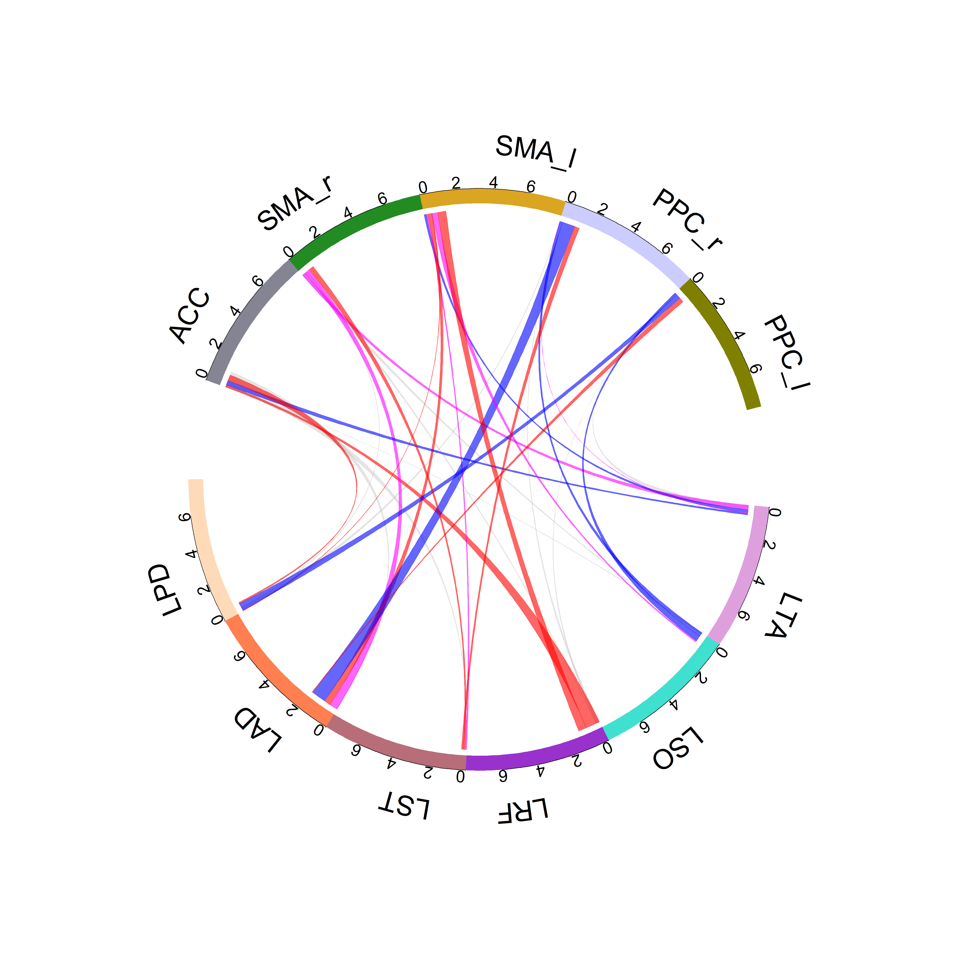
Masked vs Unmasked
LEI
LME
Unmasked
Young
Alpha
Masked

Slide 11
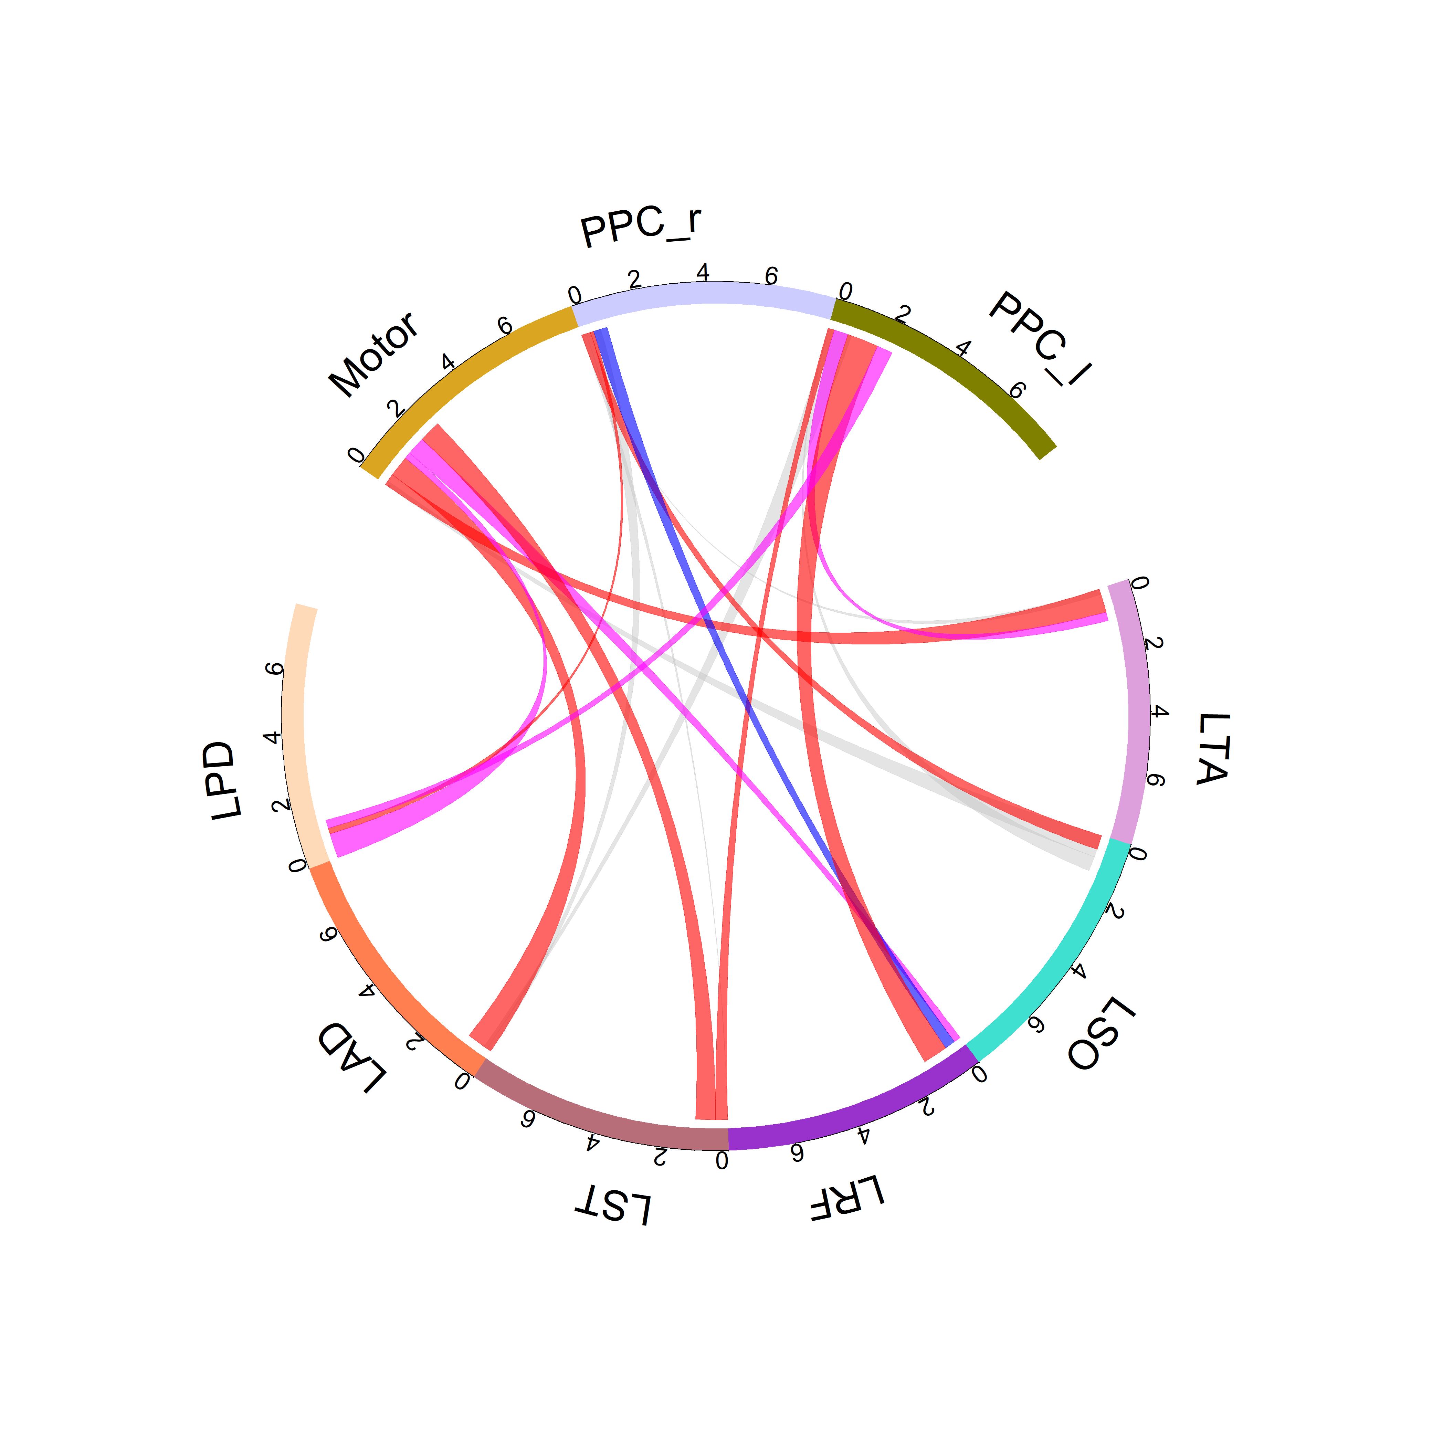
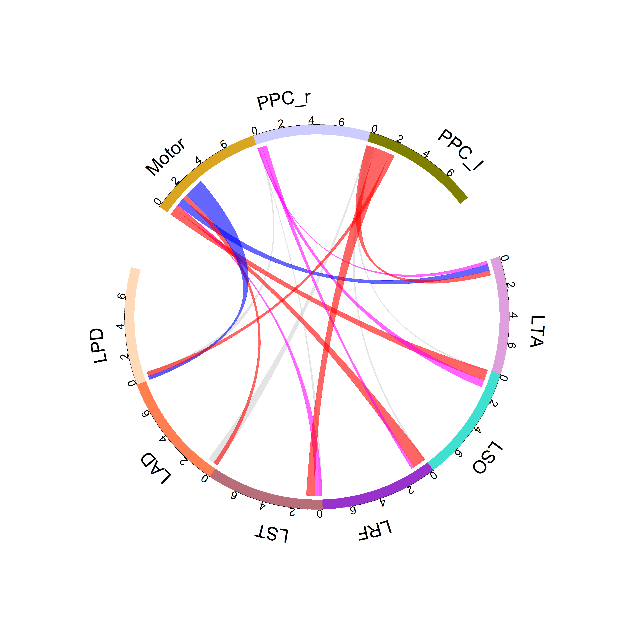
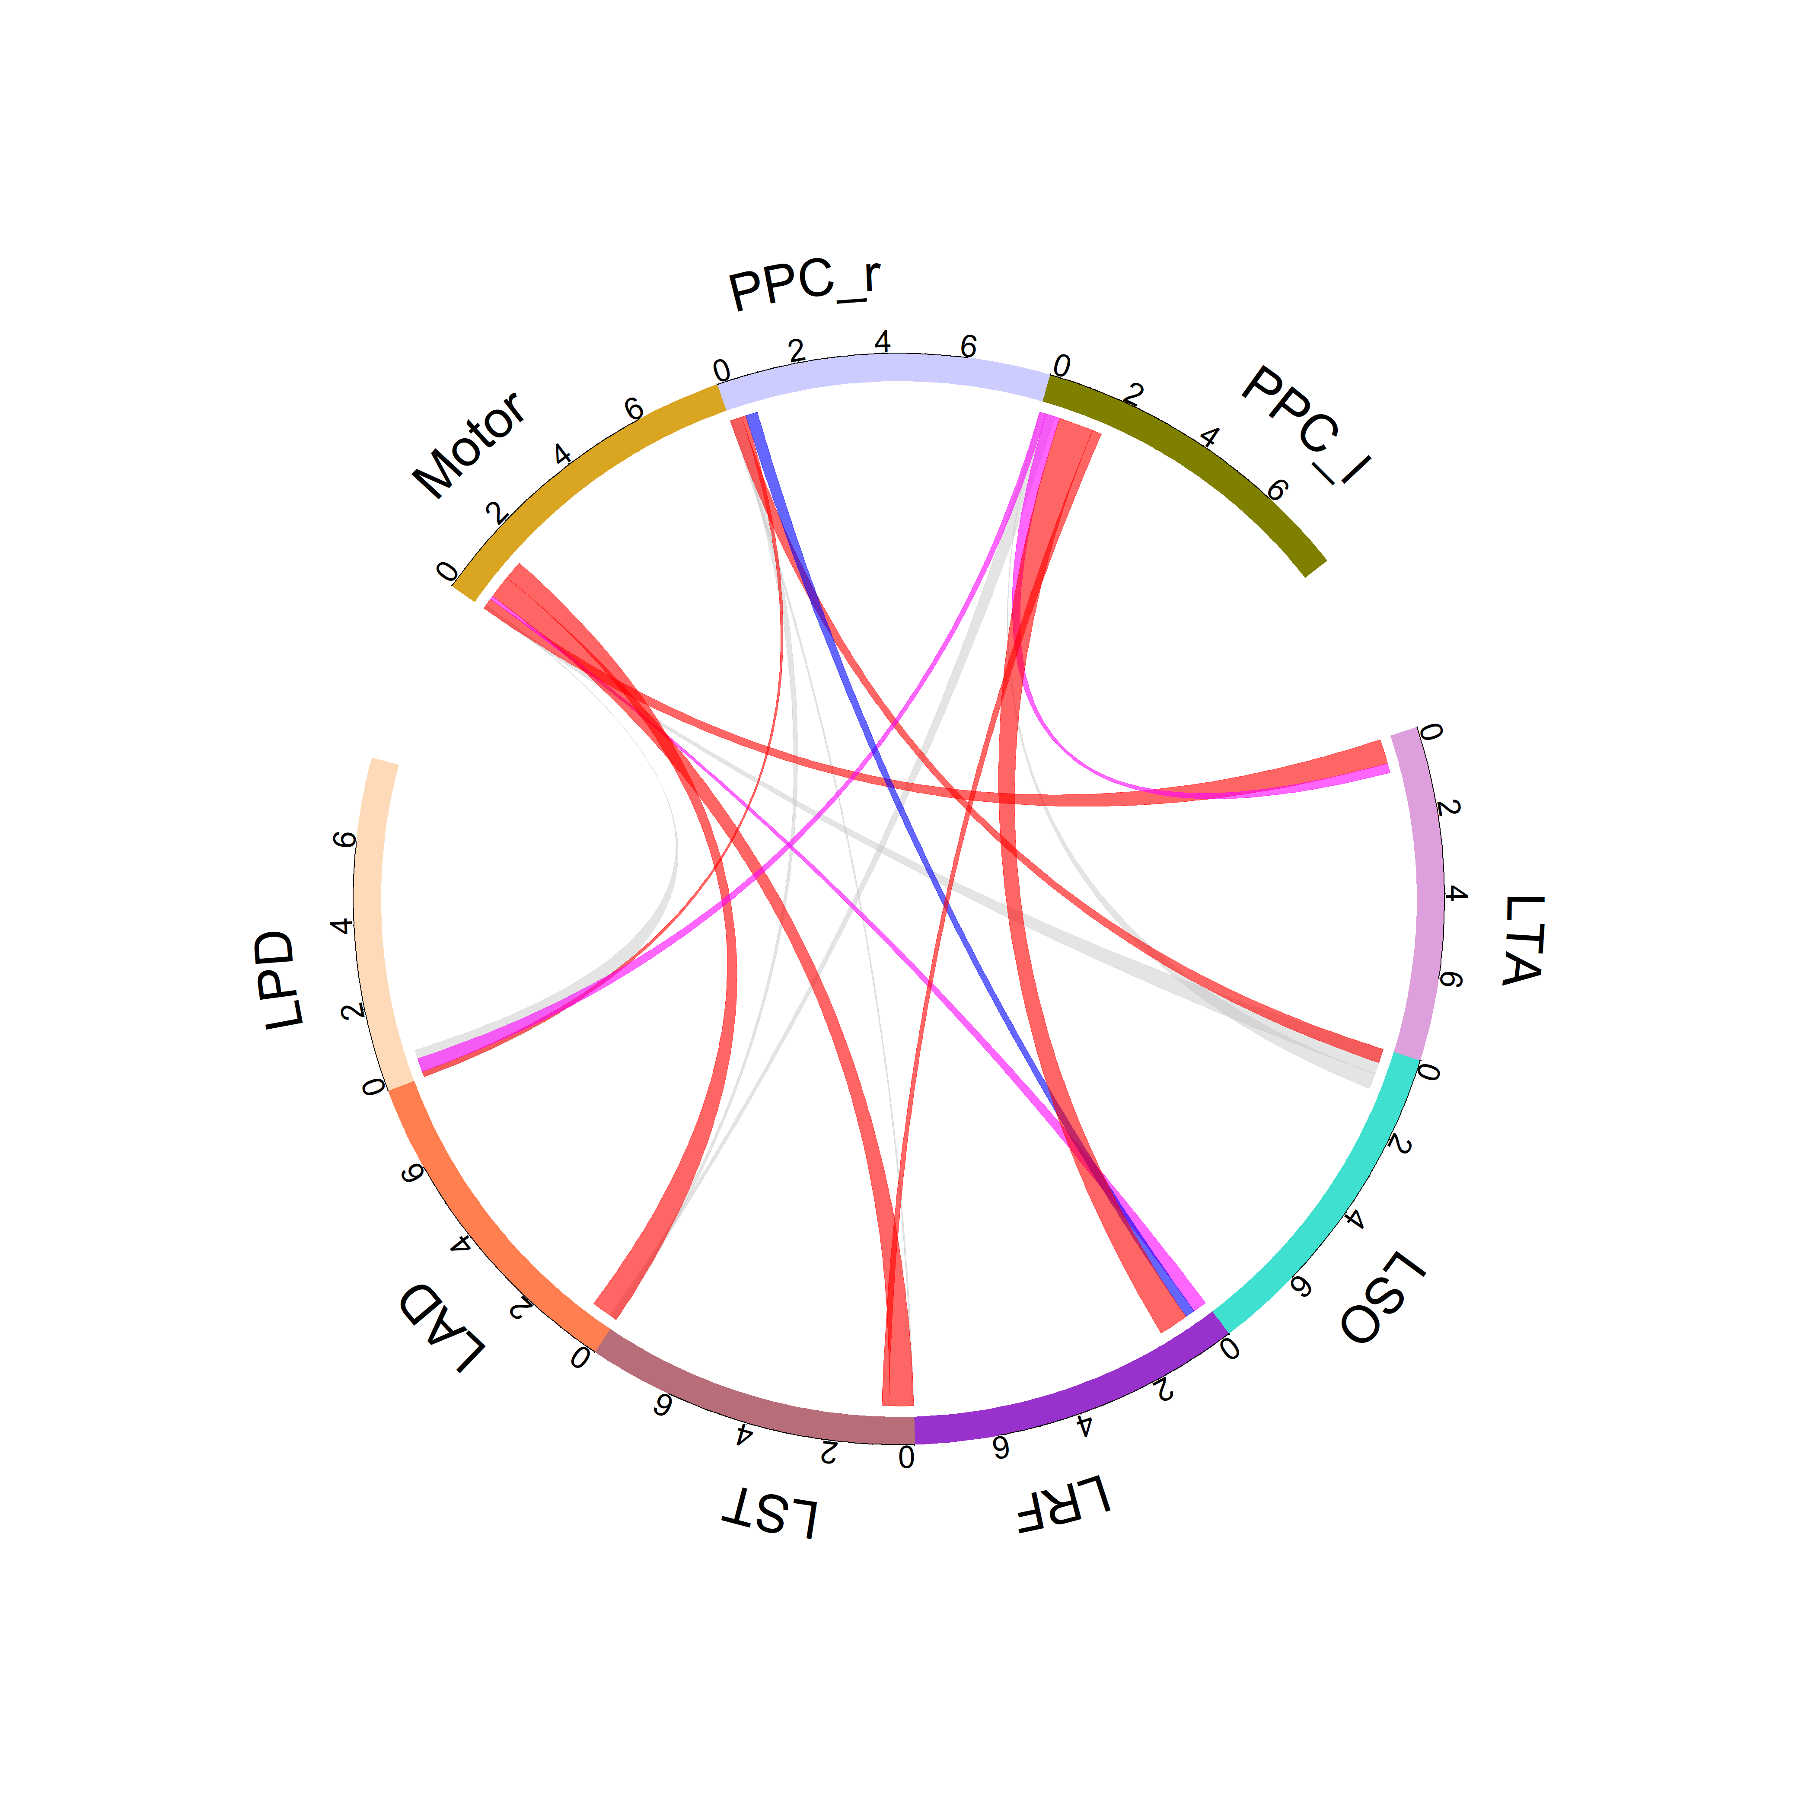
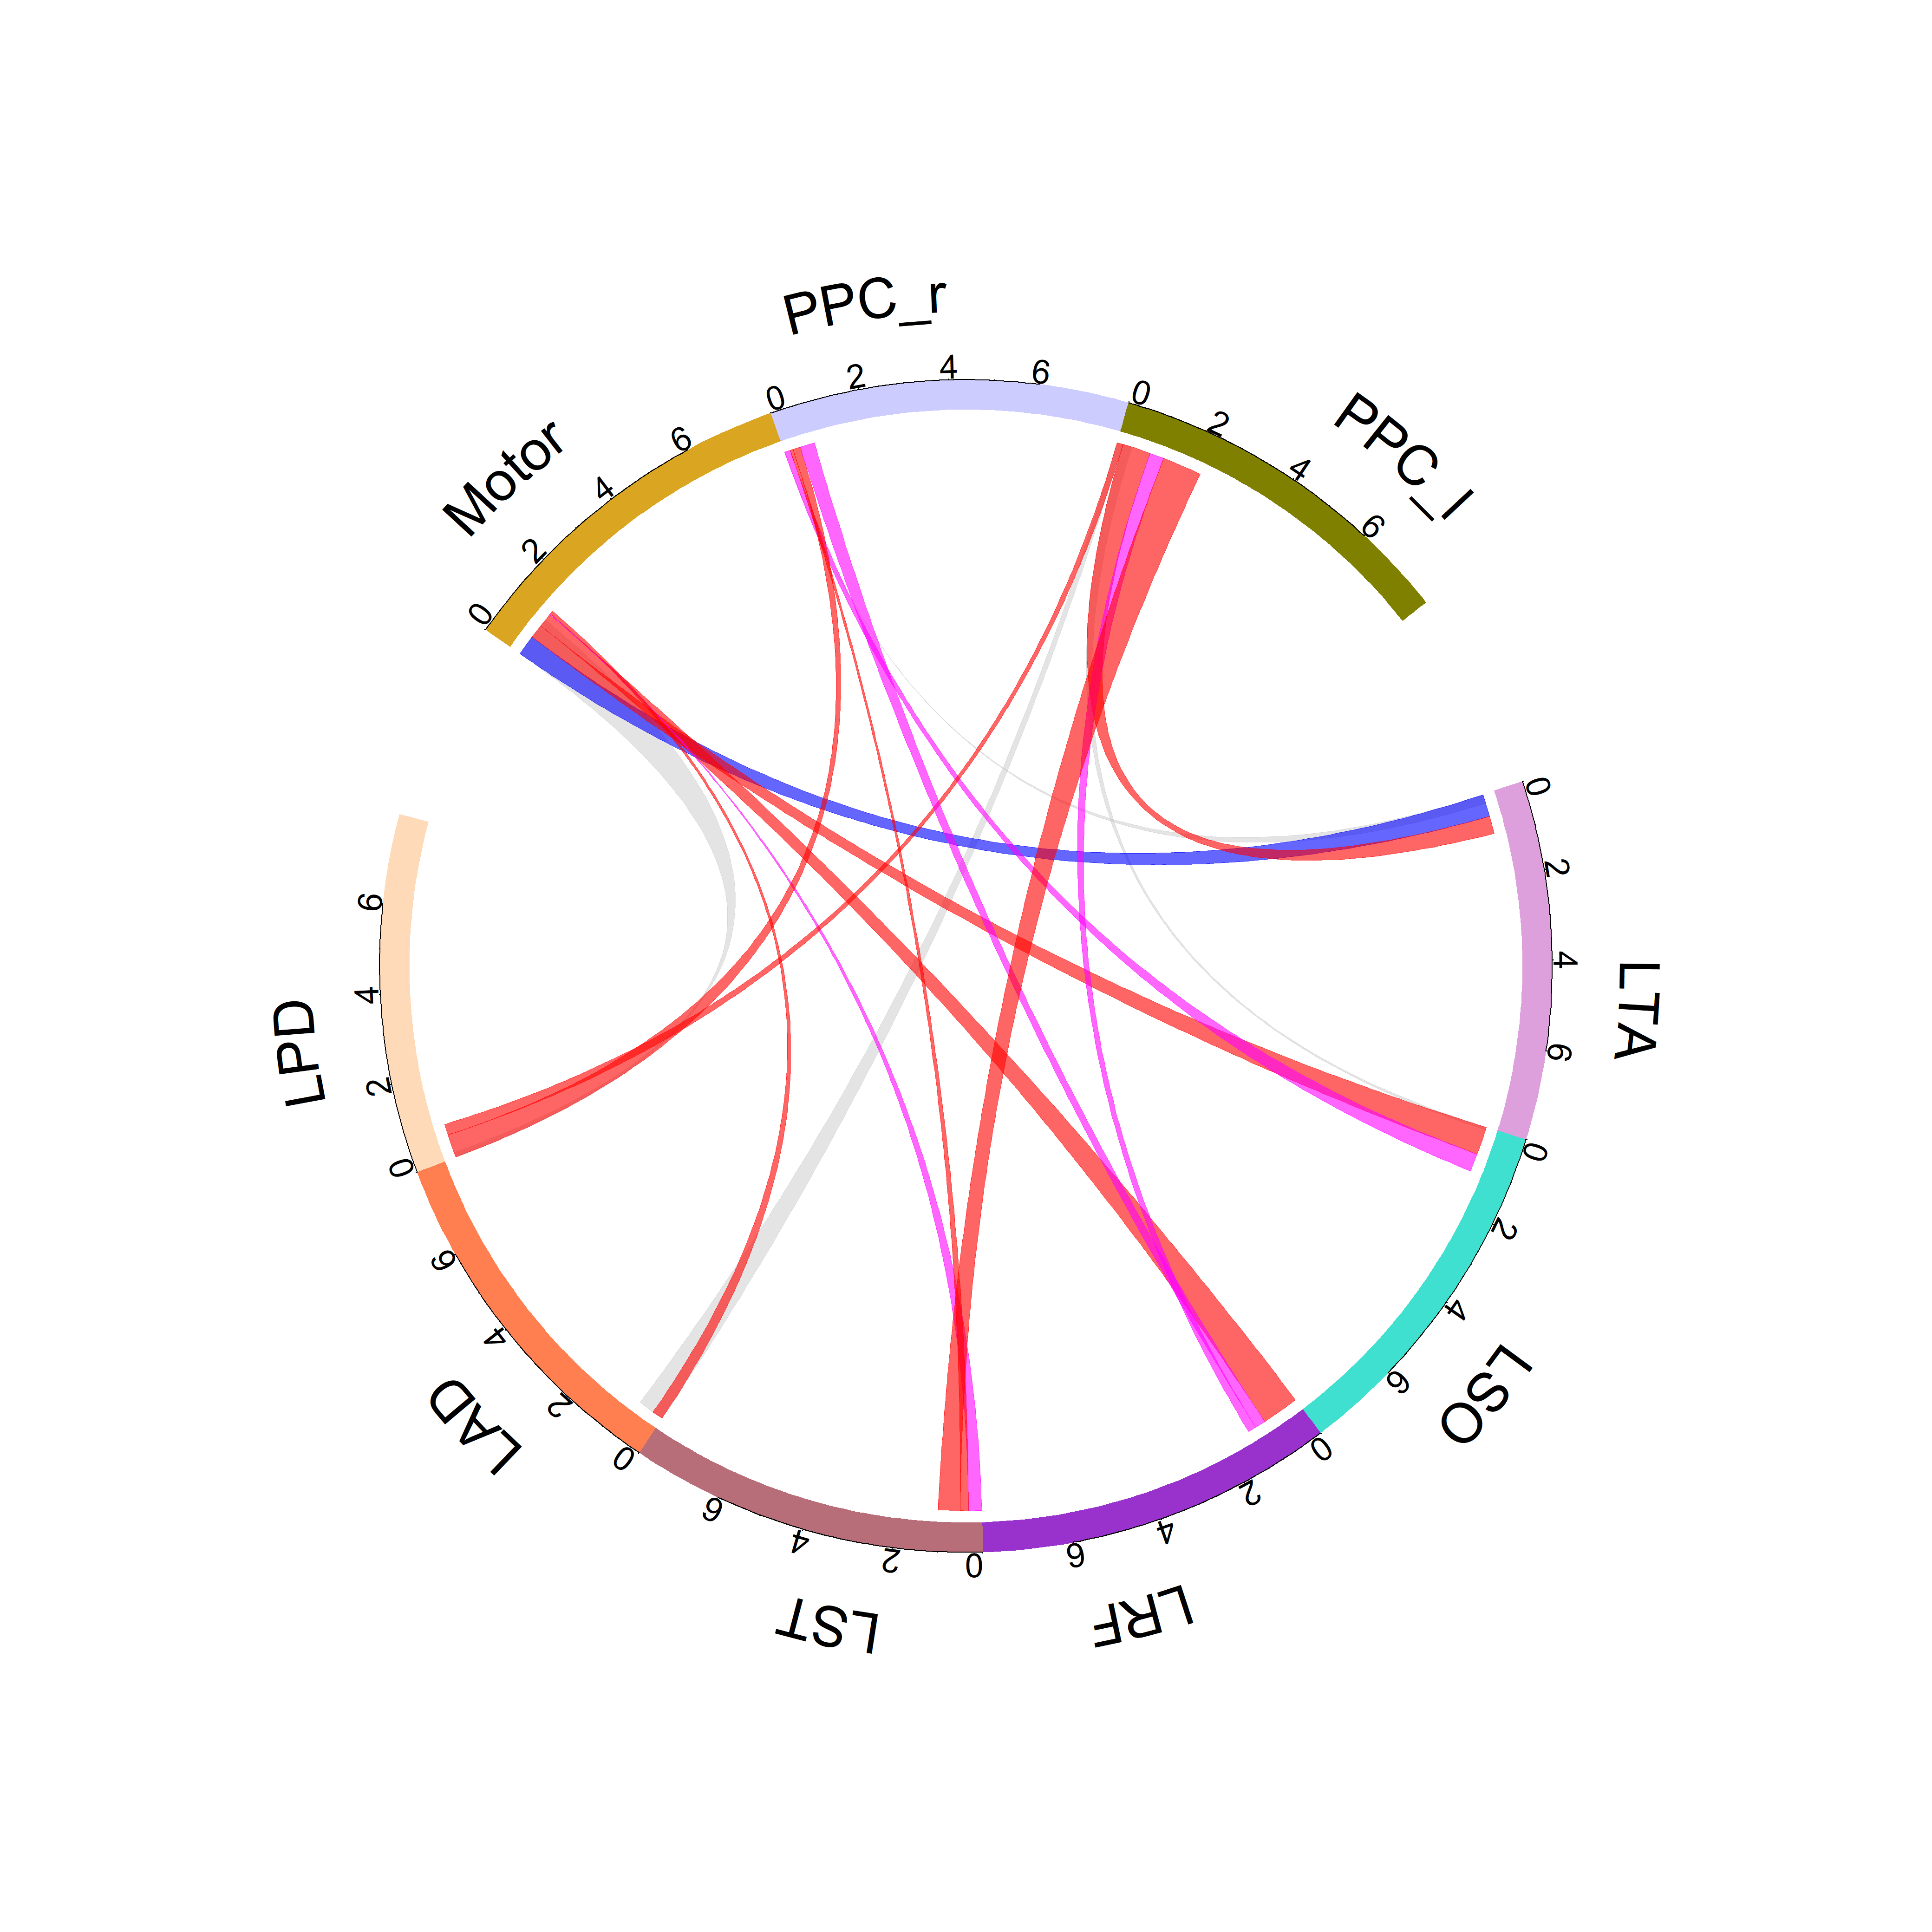
LEI
LME
Unmasked
Older
Alpha
Masked

Slide 12
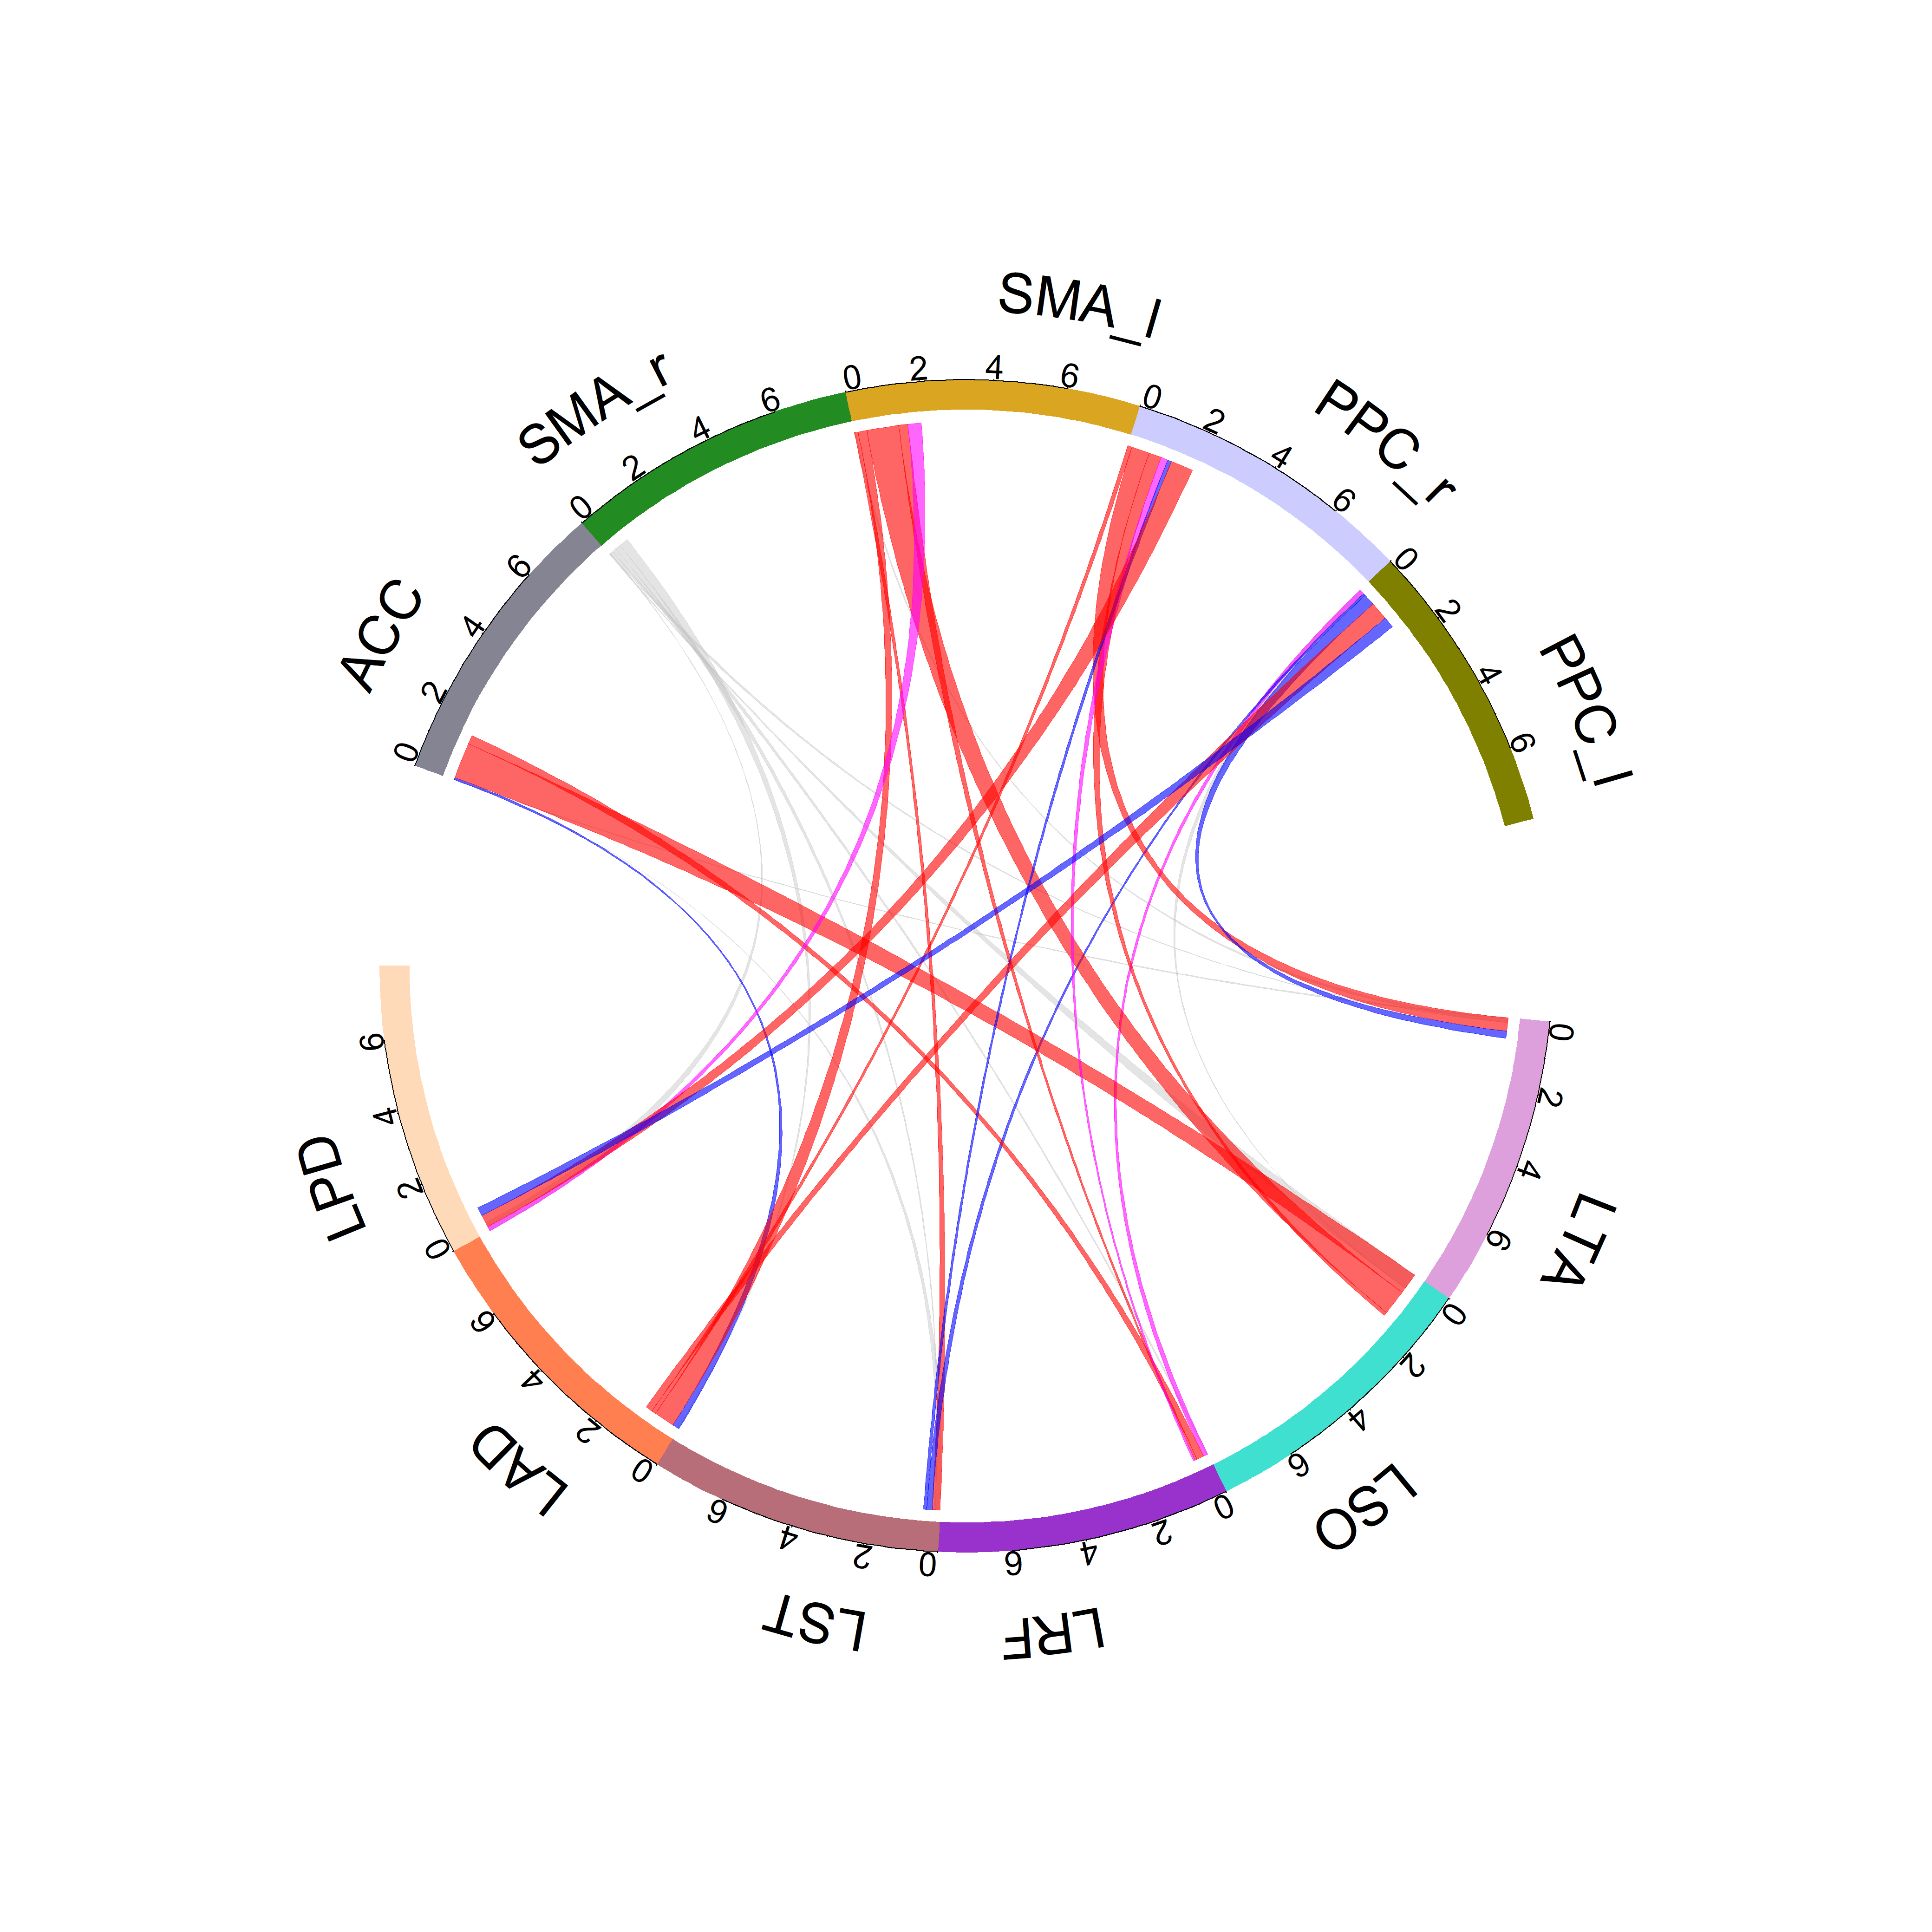
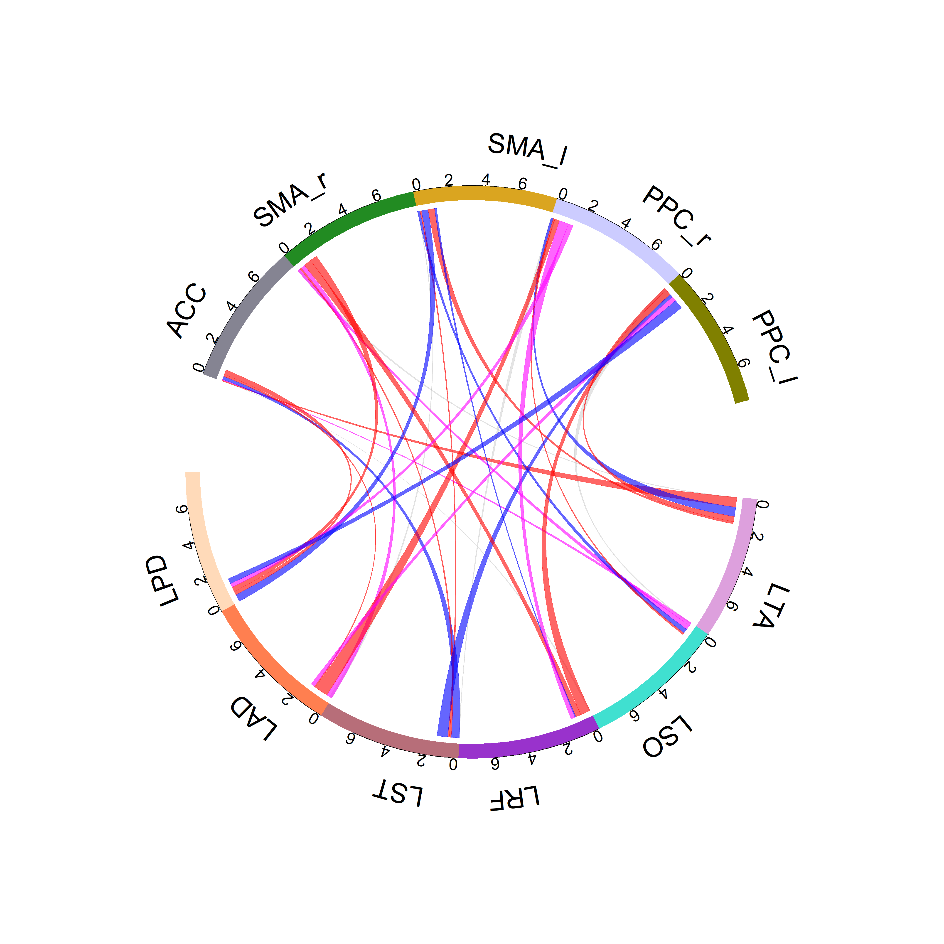
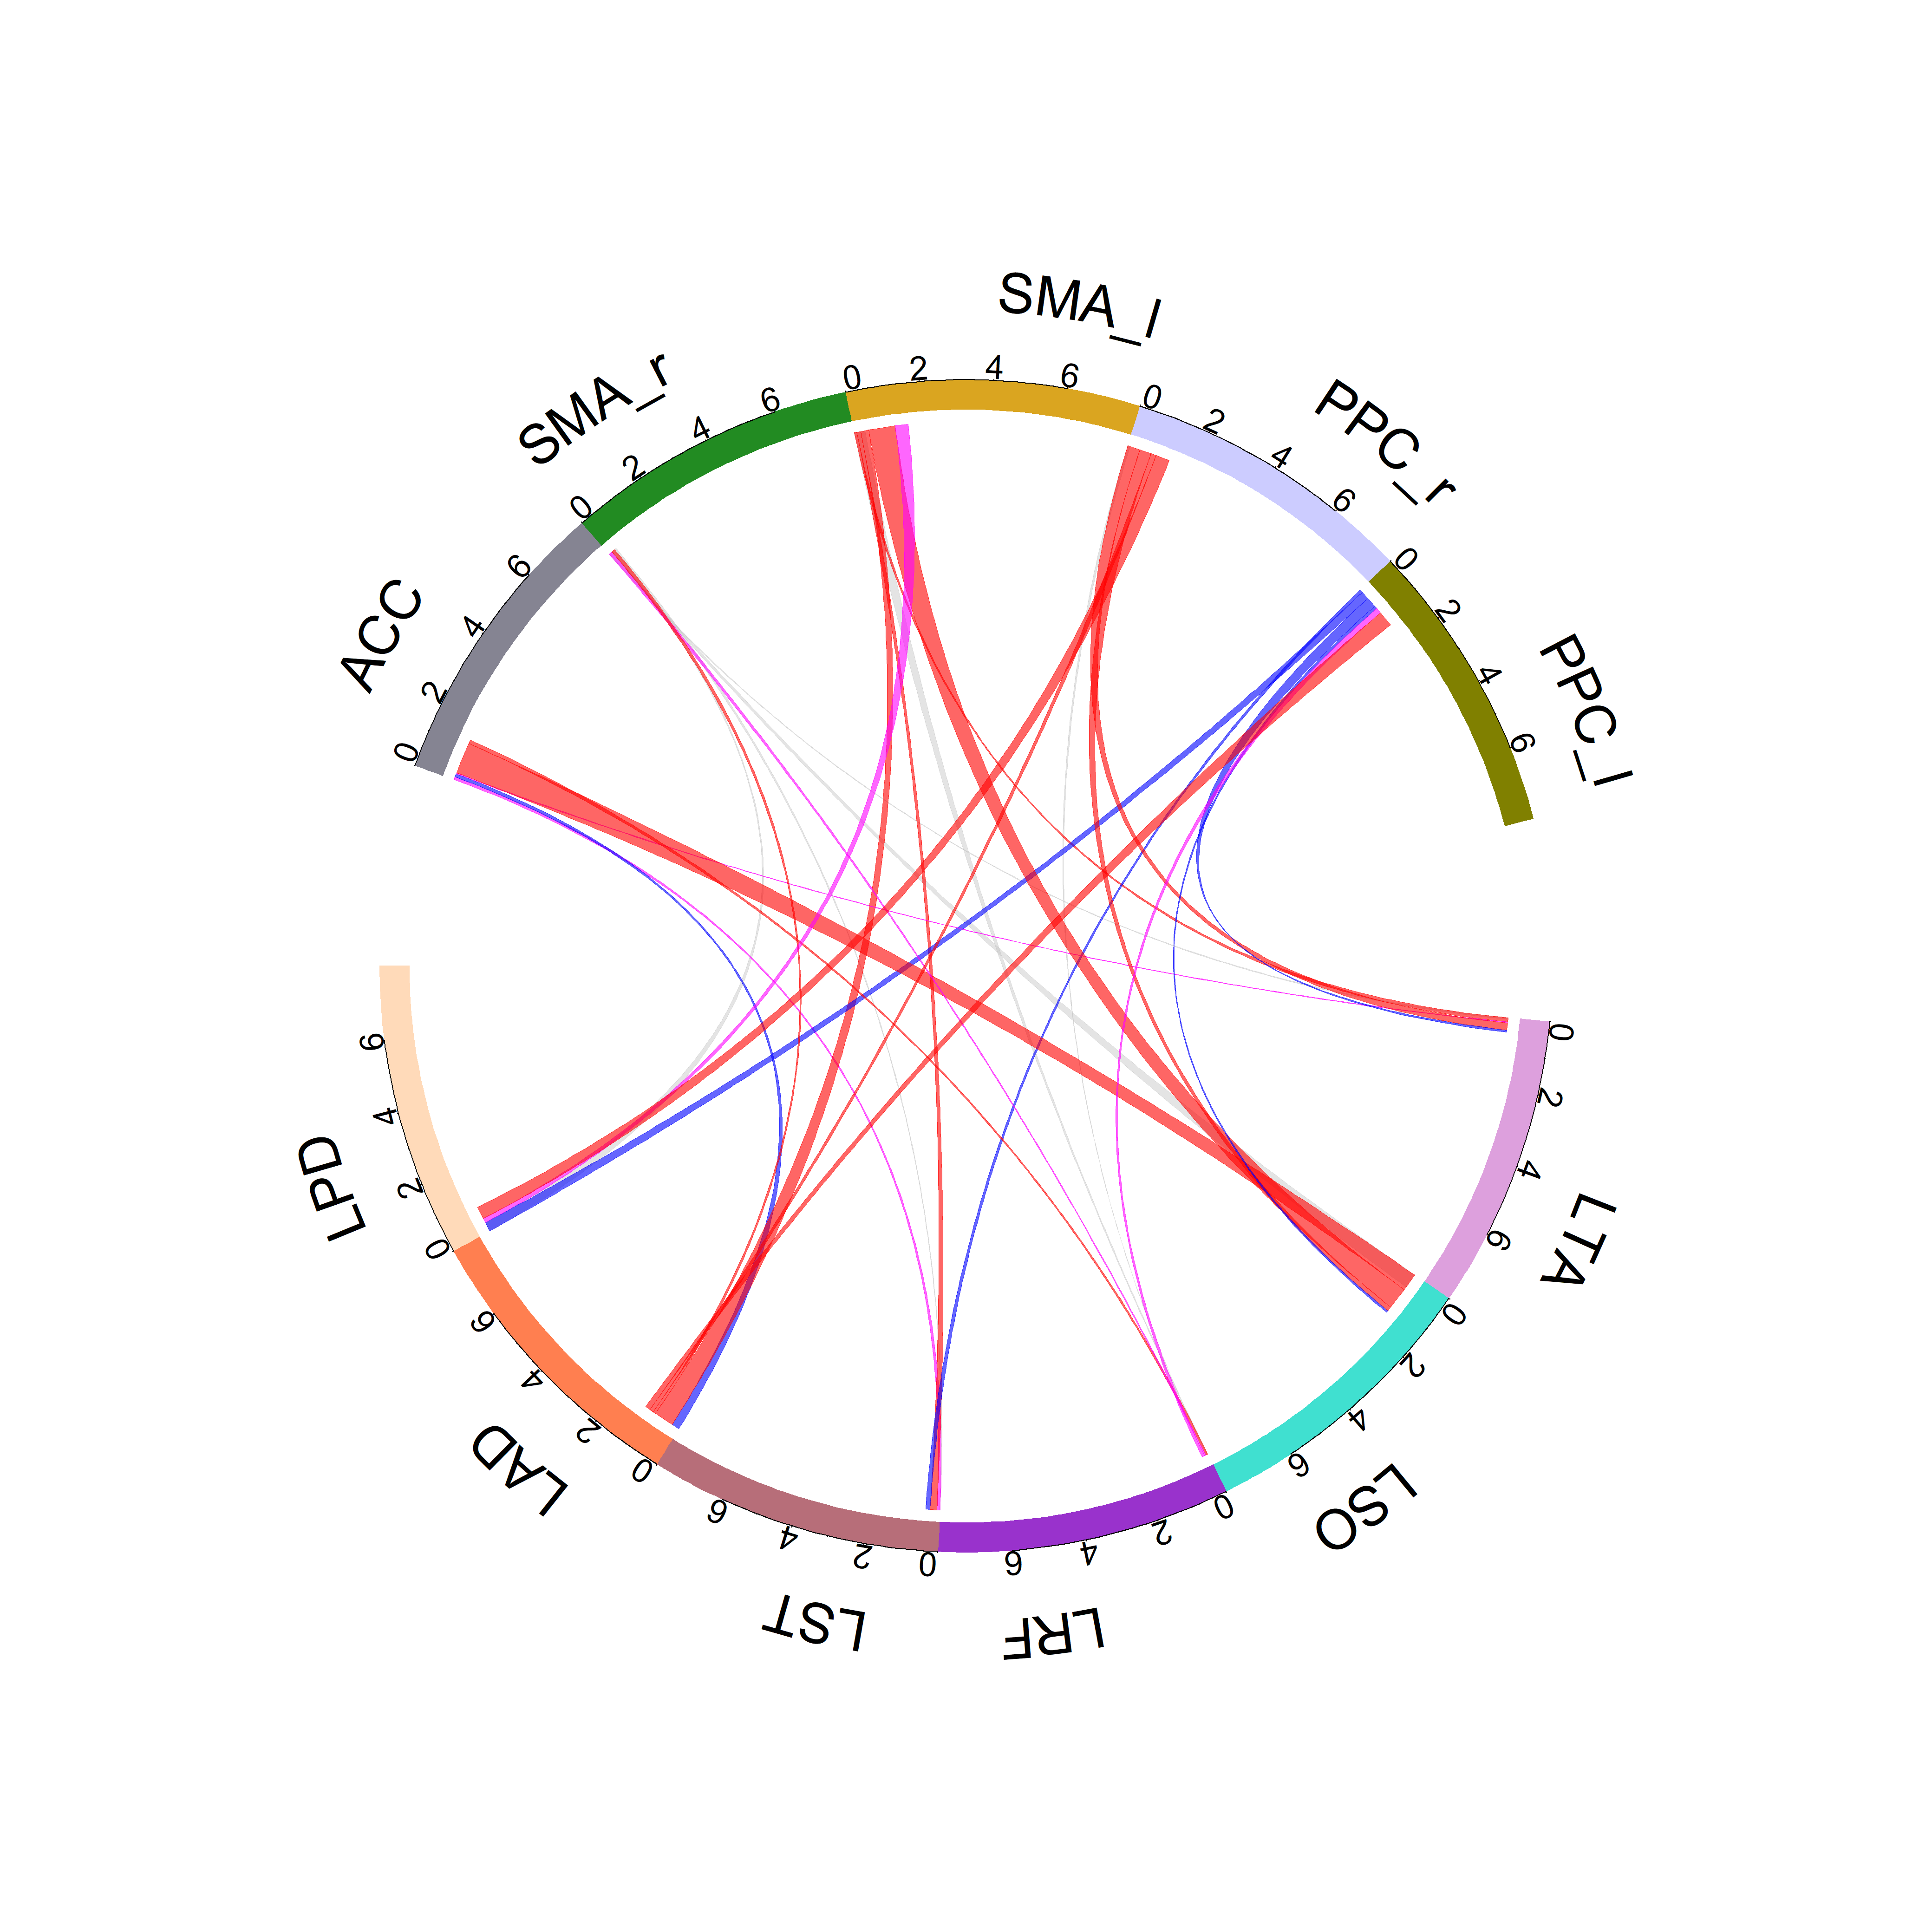
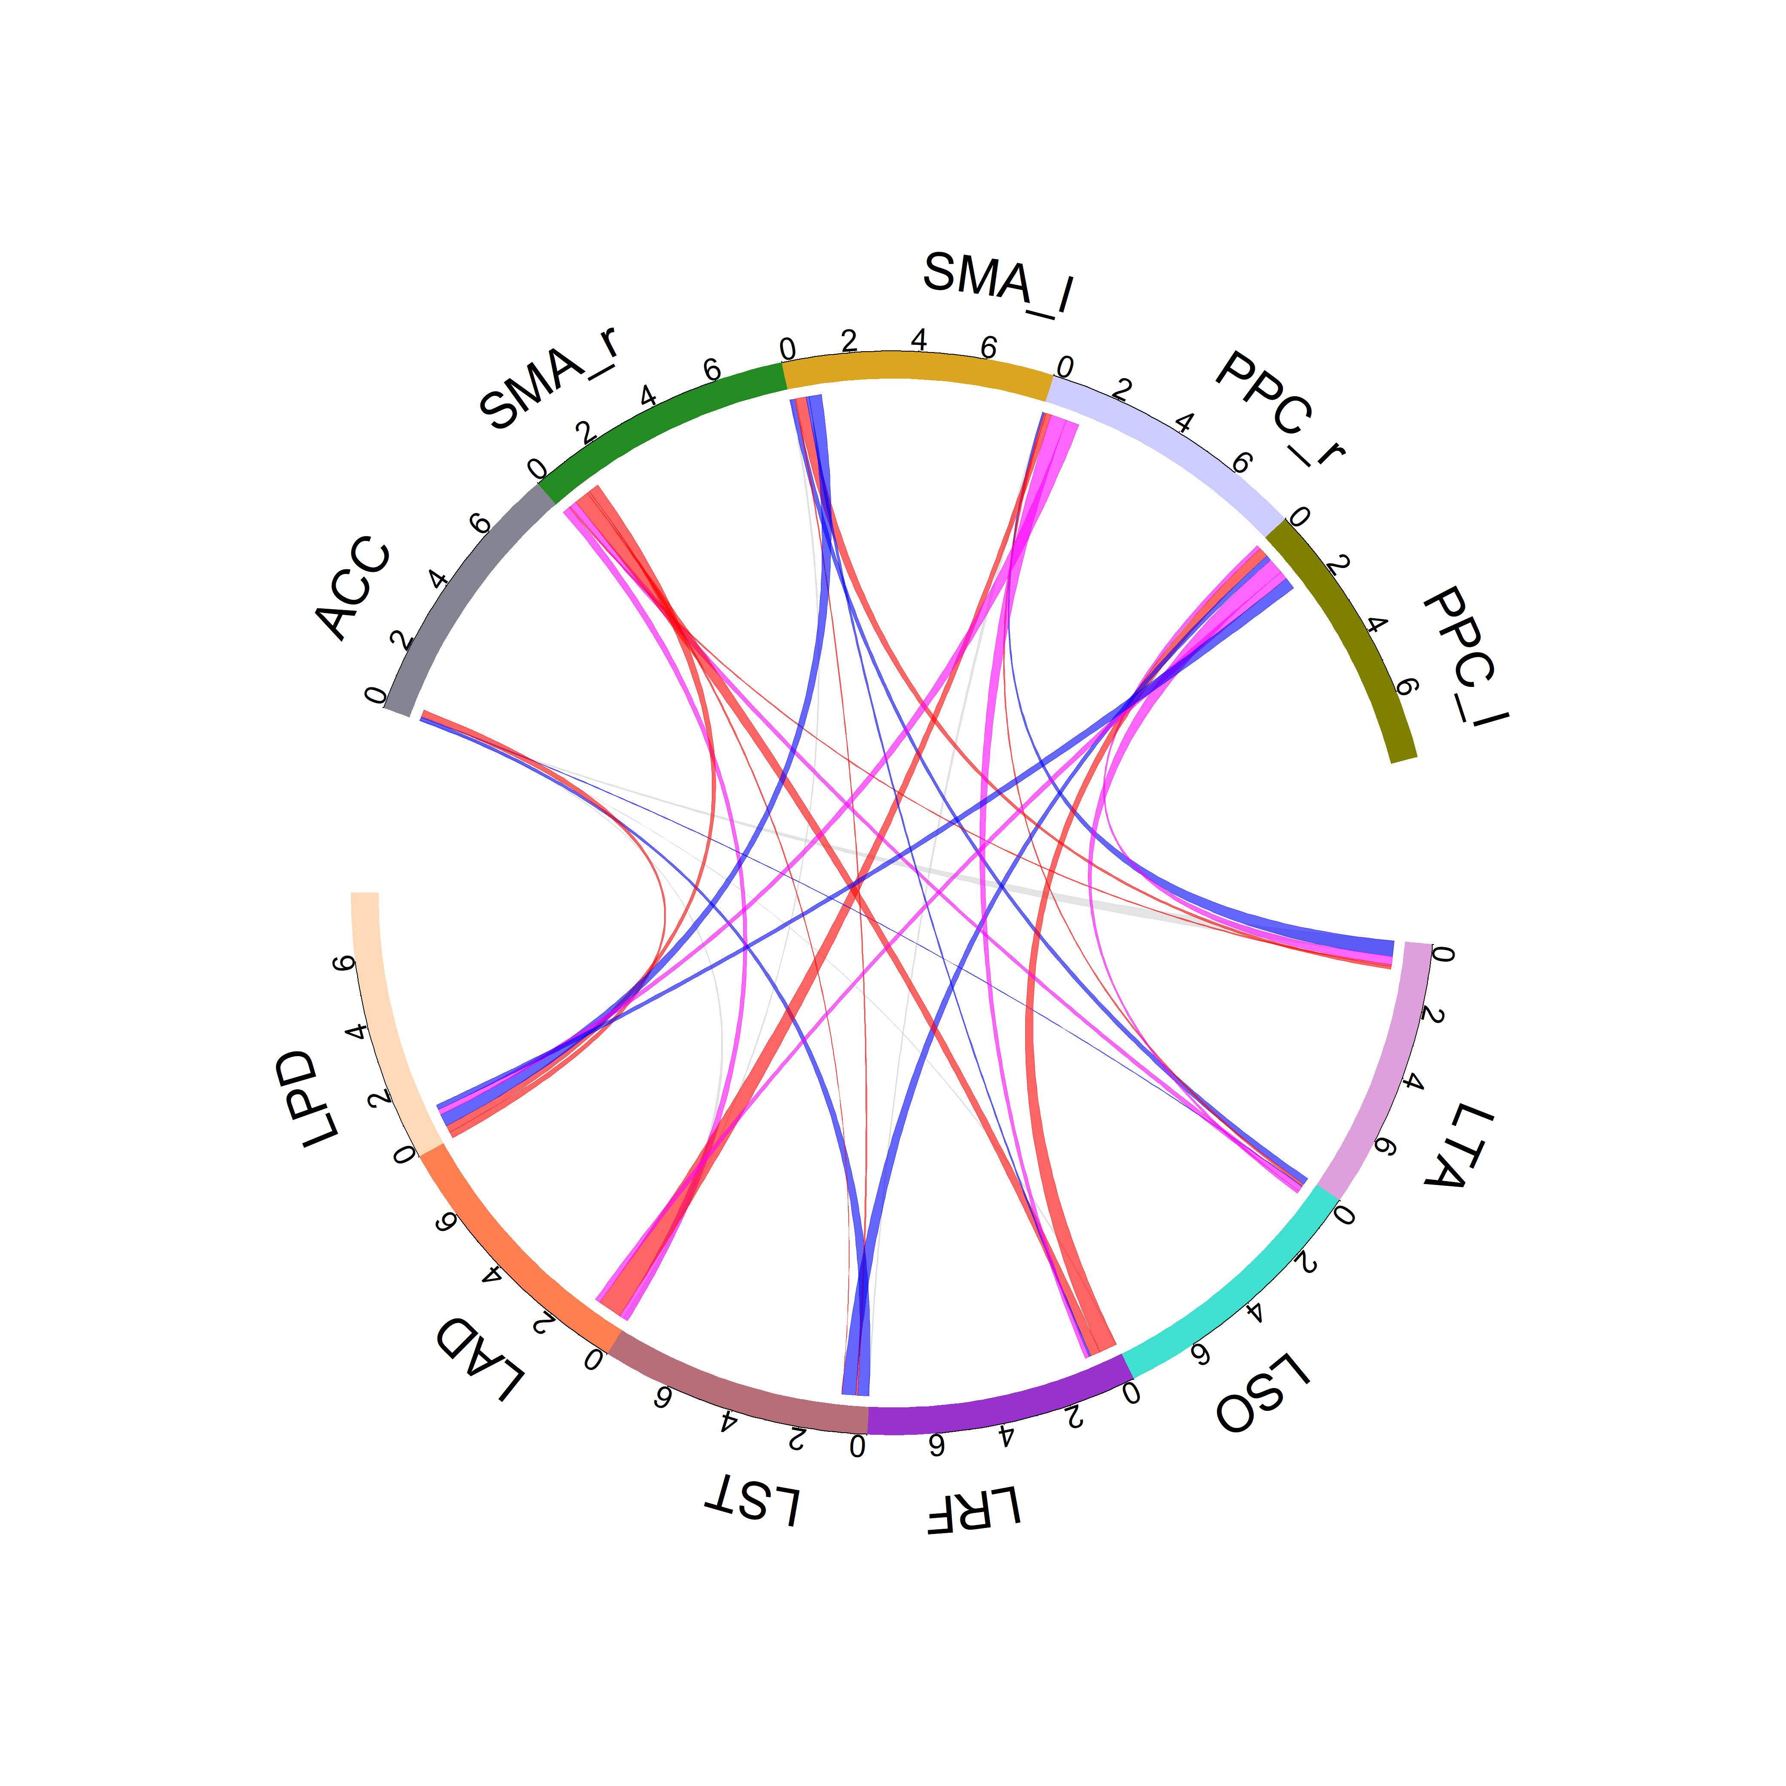
LEI
LME
Unmasked
Young
Theta
Masked

Slide 13
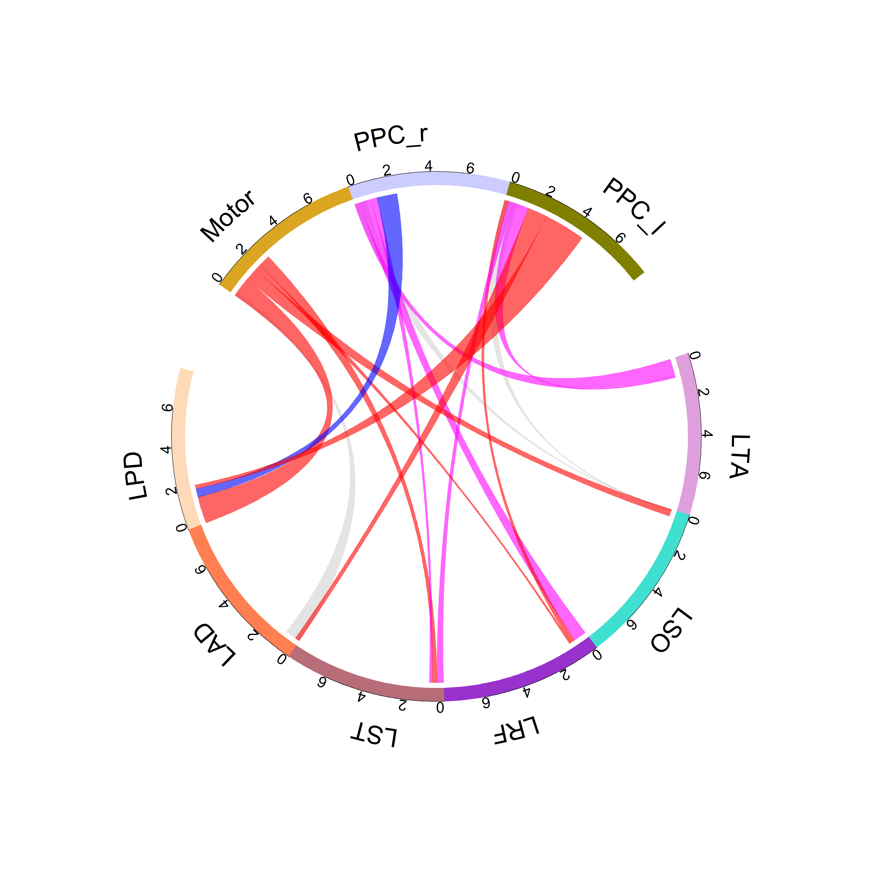
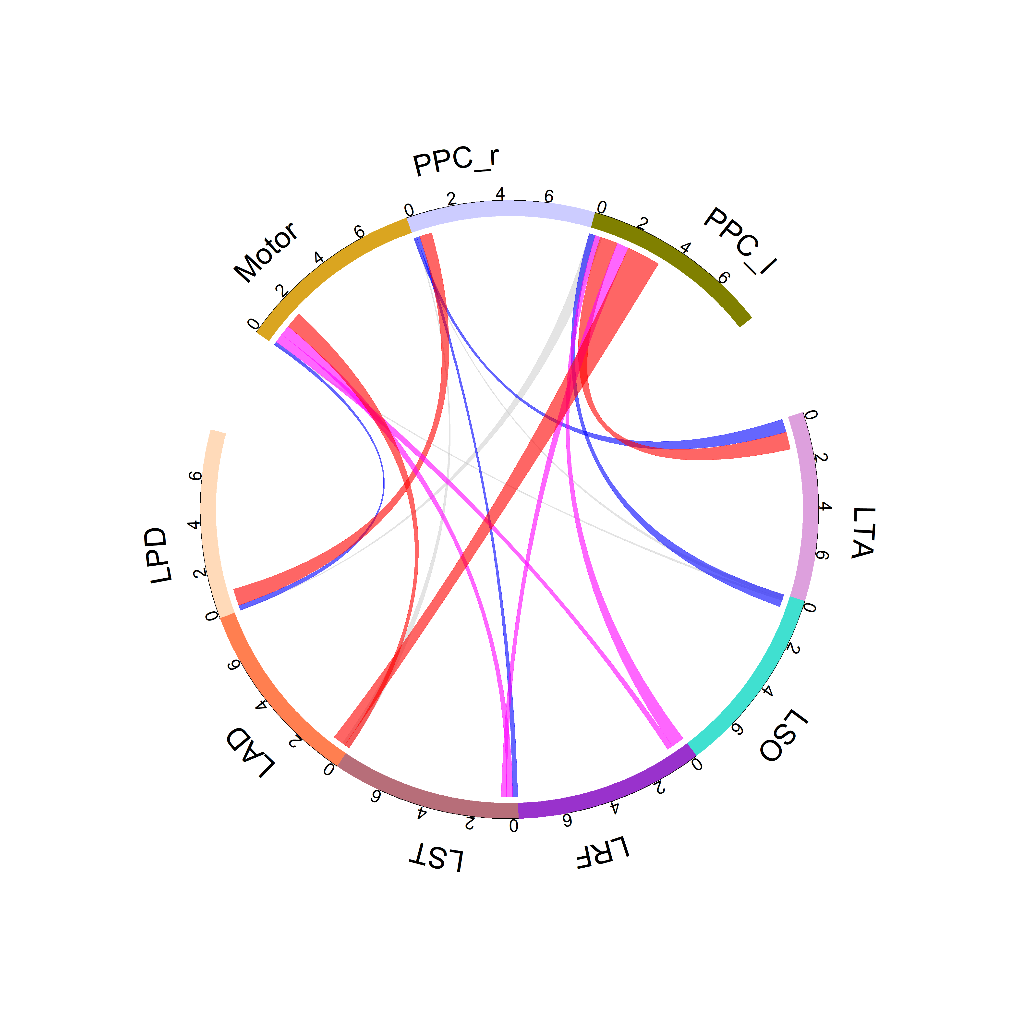
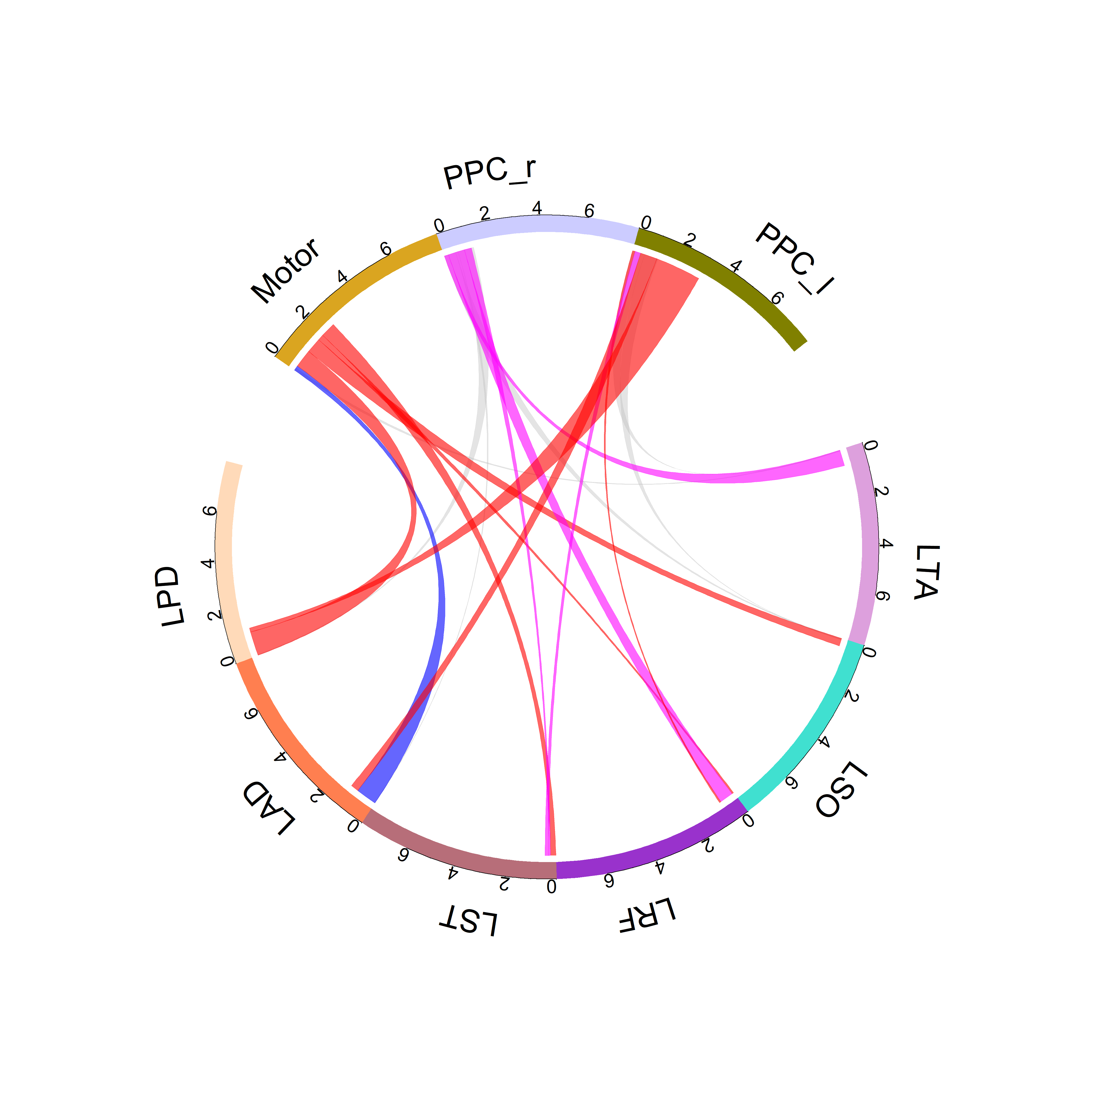
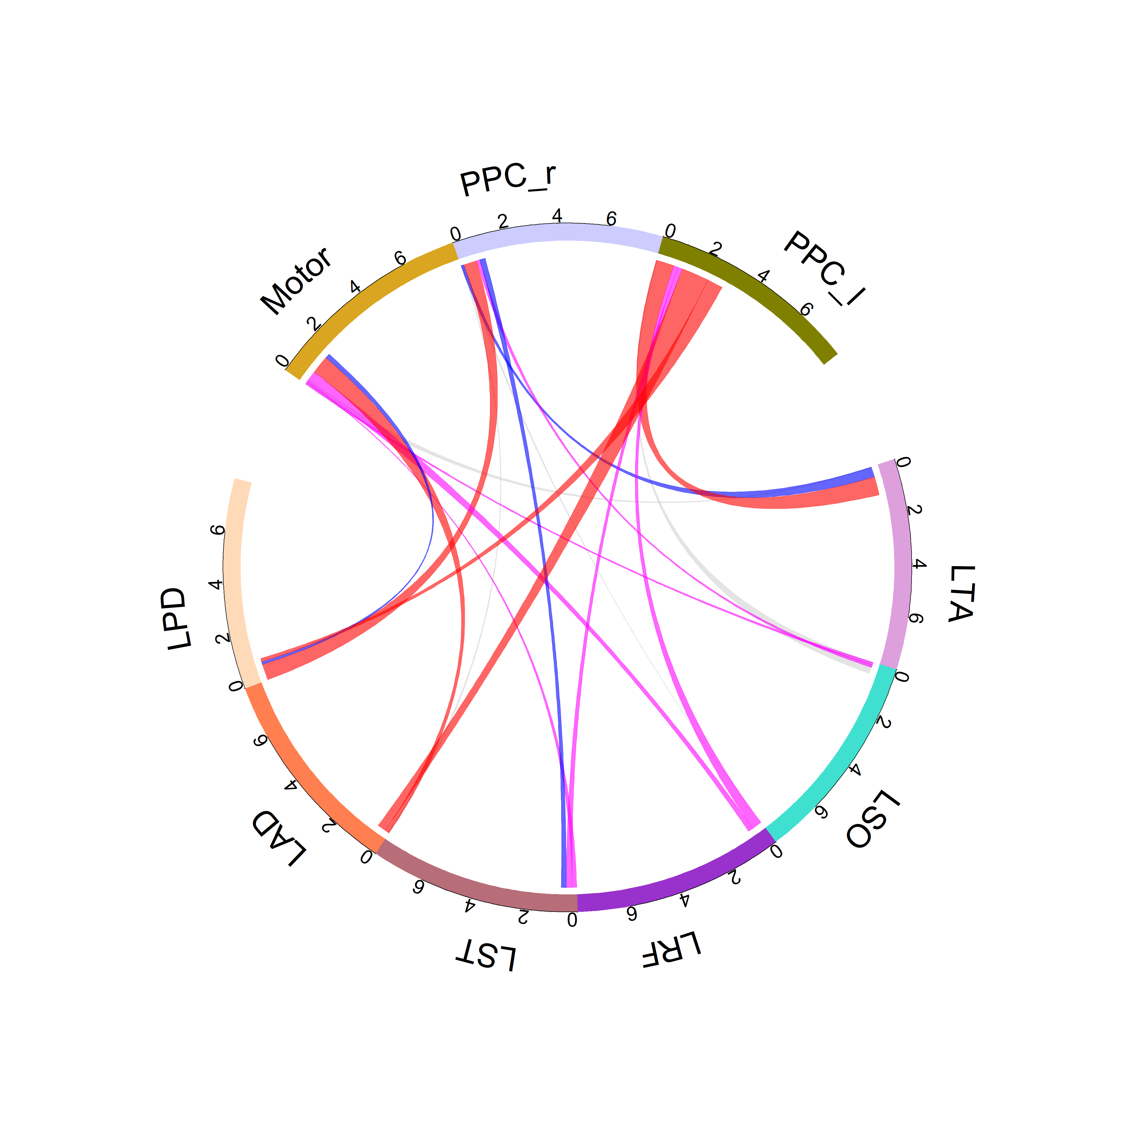
LEI
LME
Unmasked
Older
Theta
Masked

Slide 14
Young vs Older (masked)
LEI
LME
Young
Alpha
Older

Slide 15
LEI
LME
Young
Theta
Older

